Slide 1
Journaling Tool
Operations Dictionary

Slide 2
Introduction
This guide aims to define both visually and verbally which manipulation each operation is intended to represent.
Any combination of operations of can be used in manipulations.
Operations expect specific input.
Change masks and operations that contribute to the Composite must be checked for accuracy.
Operations can both effect a whole image/video (globally) or parts (locally)

Slide 3
Operation Groups
AdditionalEffect
AntiForensic
Audio
CGI
Color
Filter
Groups
Intensity
Layer
Output
Paste
PostProcessing
Select
Steganography
Time Alteration
Transform

Slide 4
AdditionalEffect
Video
Operation Name | Description
ReduceInterlaceFlicker | Smooth the artifacts resultant from interlacing
AddTransitions | Add a series of frame modifications that create a visual blend between two pieces of media
WarpStabilize | Distort and/or crop video layers in order to remove camera shake
CameraMovement | Make it appear that the camera is moving or not moving
Fading | Decreasing opacity to make scenes blend in or out. Example: Fading to Black
Mosaic | Create a mosaic pattern and then reassemble

Slide 5
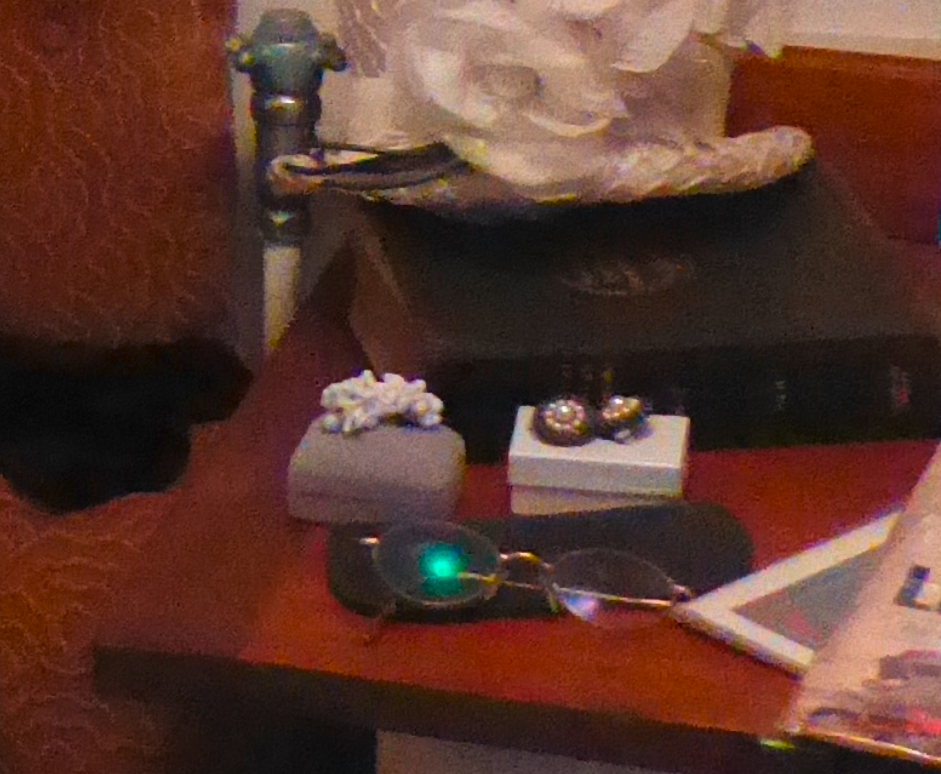
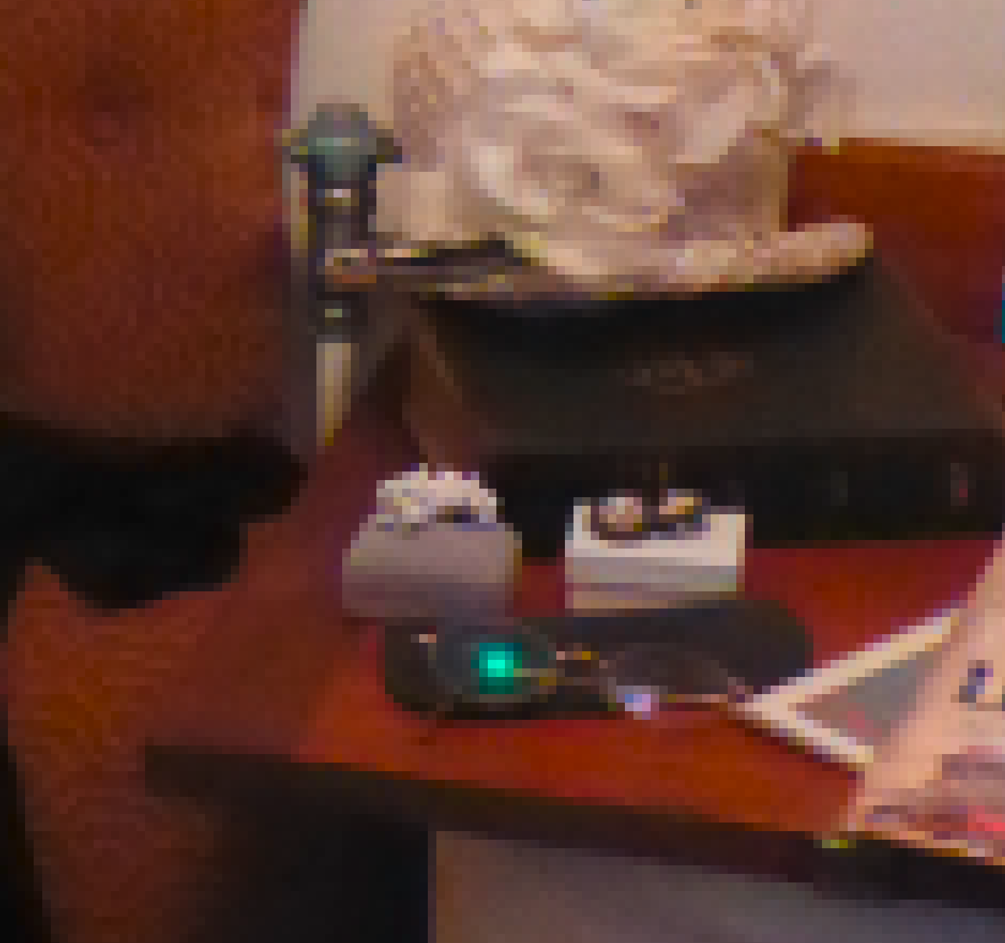
Mosaic
- Clumps pixels into square blocks. The pixels in a given block are the same color, and the colors of the blocks represent the colors in the selection.
Gives lower quality appearance without removing or losing pixels
Requires input for horizontal and vertical grid size
Before
After
original
7x7 mosaic, sharp colors,No

Slide 6
Audio
Operation Name | Description
AudioSample | Extract audio stream(s) from a video
AudioCompress | Compress Audio Signal
AudioCopyAdd | Copy audio stream(s) from one section of video to another (or one stream to the other)
DeleteAudioSample | Remove a portion or all of an audio stream from a video
AudioReverb | Add Reverb or Dampen an Audio Signal to alter the perception of the room size
AudioAmplify | Adjusting the amplitude of an Audio Signal by increasing, decreasing or cross-fading
AddAudioSample | Adding a donor audio stream to a video
ReplaceAudioSample | Replacing with a donor audio stream to a video
AudioEffect | Apply an effect to audio stream
AudioFilter | Apply filter to audio stream

Slide 7
AntiForensic
Operation Name | Description
Add Camera Model | Copy Metadata information from a source
AntiForensicCopyExif | Copy metadata information from a source
AntiForensicEditExif | Alter image metadata
AntiForensicJPGCompression | Use quanitization tables and exif data from a particular camera to save an image as JPG
AntiForensicDither | Disguise quantization artifacts by adding noise
AntiForensicExifQuantizationTable | Alter image to be compliant with another images quantization and EXIF
CFACorrection | Image Sensors
LensDistortion | Apply artificial lens distortion
AddCamFingerprintPRNU | Add PRNU fingerprint from image
RemoveCamFingerprintPRNU | Remove PRNU fingerprint from image
AddCamFingerprintAveragePRNUFromSet | Add PRNU fingerprint trace, generated from a set of images
ErasurebyGAN | Remove effects of manipulations depending on the GAN model and architecture
RemoveCamFingerprintAveragePRNUFromSet | Remove PRNU fingerprint trace, generated from a set of images
AberrationCorrection | Chromatic Aberration Correction
BitRescale | Rescale pixel intensity to remove gaps in the histogram. Images will appear darker. Displays tools adjust based on range of intensity

Slide 8
CGI
Operation Name | Description
ArtificialLighting | Add sources of illumination that were not originally present
OverlayObject | Add an object to another image or selection. Do not use a donor image. Consider using ObjectCGI.
DigitalPenDraw | Use the pencil or brush tool to add a pixel overlay to an image or selection
Handwriting | Use the pencil or brush to add a look of handwriting to an image or selection
ObjectCGI | Create objects that were not originally present in an image
SynthesizeGAN | Synthesize an image using a trained GAN model and provided input
OverlayText | Add text to an image or selection. Do not use a donor image. Donor images must be inserted using a PasteSplice operation.
Gradient | Apply a donor adjustment within a selection with scaling intensities
ArtificialReflection | Add sources of reflection that were not originally present
ArtificialShadow | Add shadows that were not originally present
CGIFill | Uniformly alter the color of an image within a given selection
SynthesizeVideo | Synthesize a video scene using a trained GAN model and provided input

Slide 9
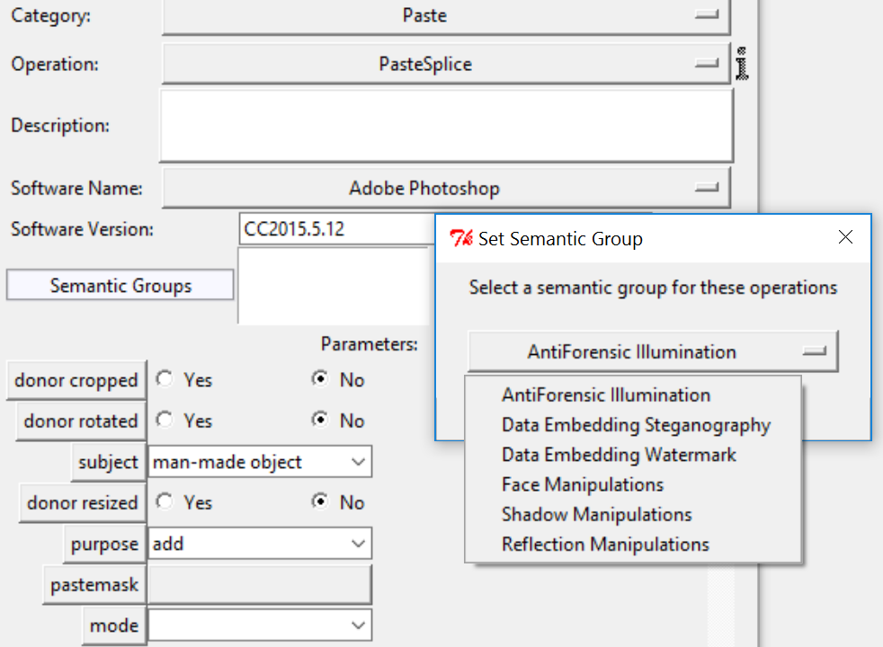
CGI
ArtificialLighting
OverlayObject
DigitalPenDraw
Handwriting
ObjectCGI
SynthesizeGAN
OverlayText
Gradient
ArtificialReflection
ArtificalShadow
CGIFill
SynthesizeVideo
Do not forget to tag any appropriate links with the correct semantic group.
Use artificial reflection and artificial shadow whenever adding them in the image, if they are for a CGI object or not. This could include the drop shadow effect, etc.

Slide 10
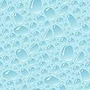
CGI
CGIFill
Gradient
DigitalPenDraw
Pattern
DeepFakeFaceSwap
Gradient
DigitalPenDraw
CGIFill-Pattern
CGIFill-uniform color

Slide 11
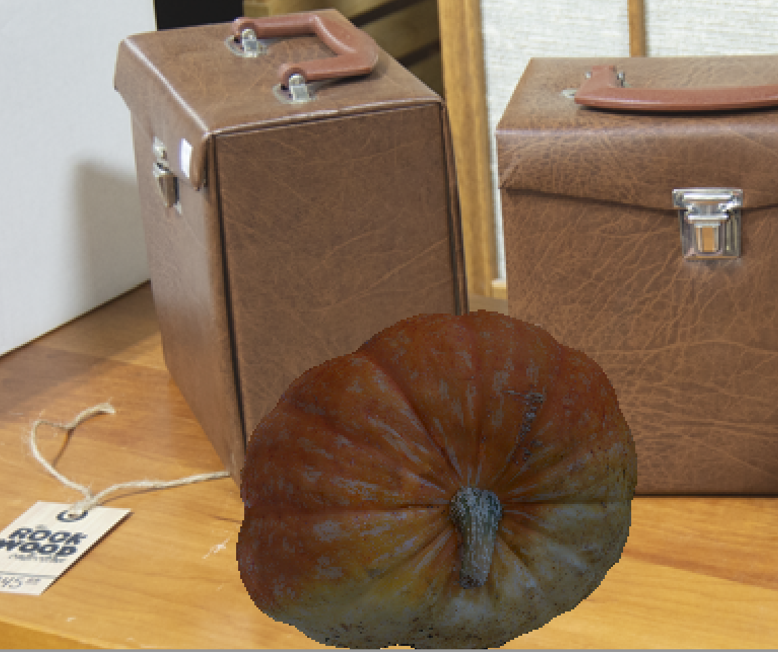
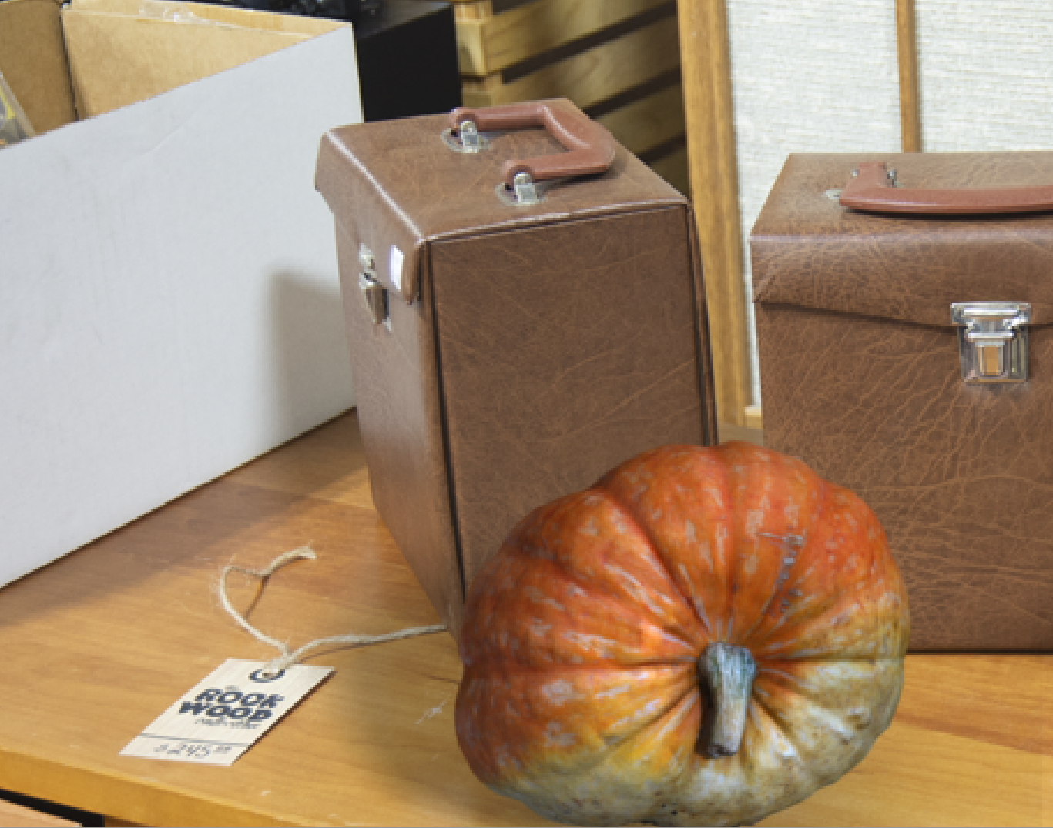
ArtificialLighting
- Adding in lighting and shadows, generally onto CGI objects added into a 2D scene.
- Often linked to adding a shadow or reflection or, antiforensic artificial lighting – when the physical attributes are intentionally matched to the other objects.
Before
After

Slide 12
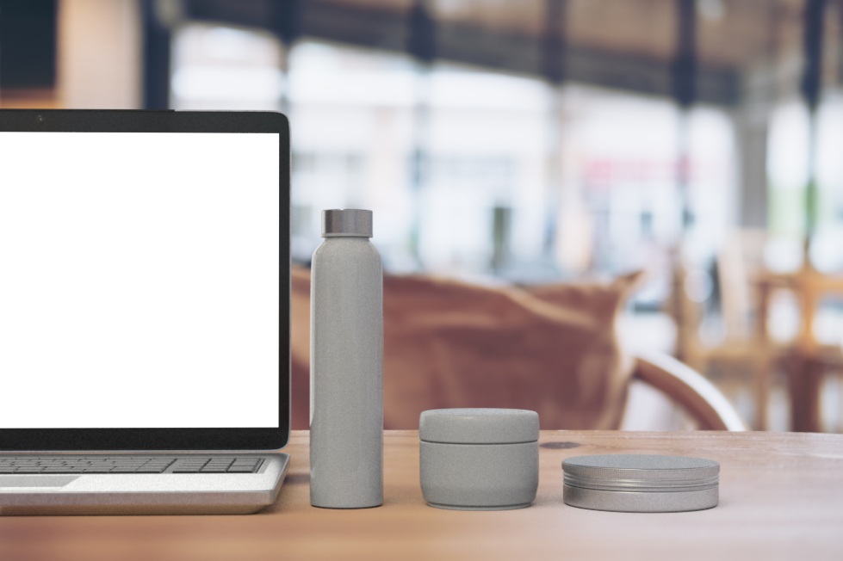
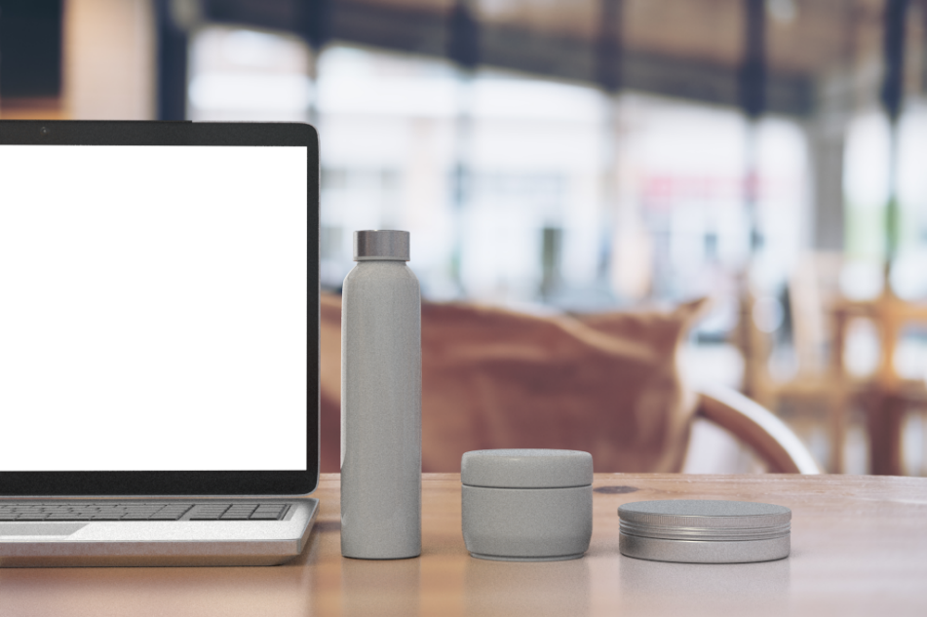
ArtificialReflection
Reflection
Add a reflection
Before
After

Slide 13
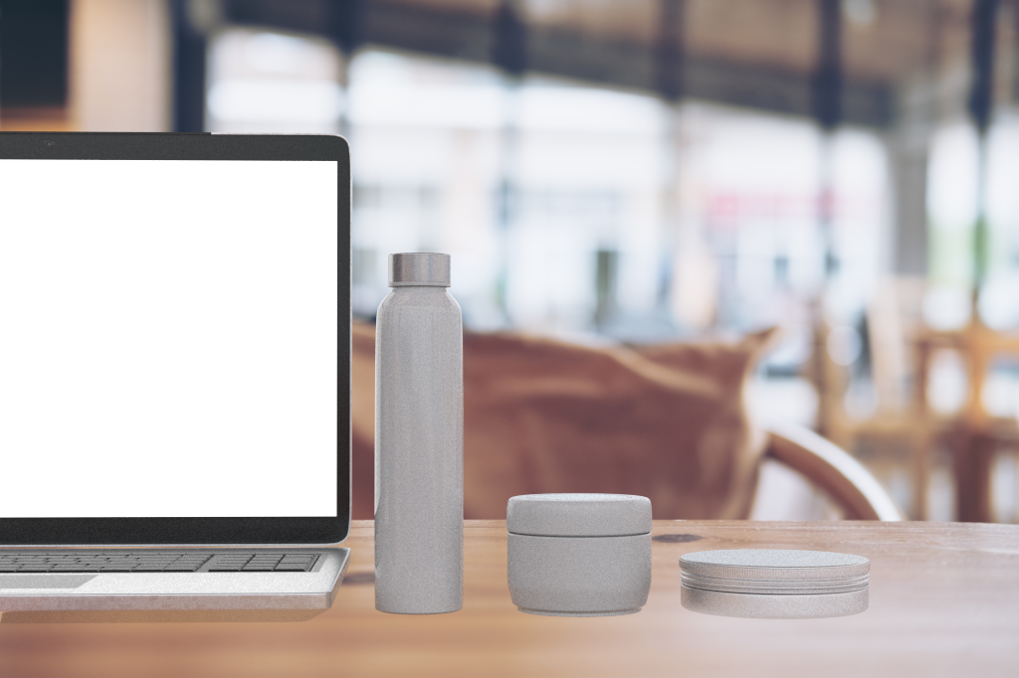
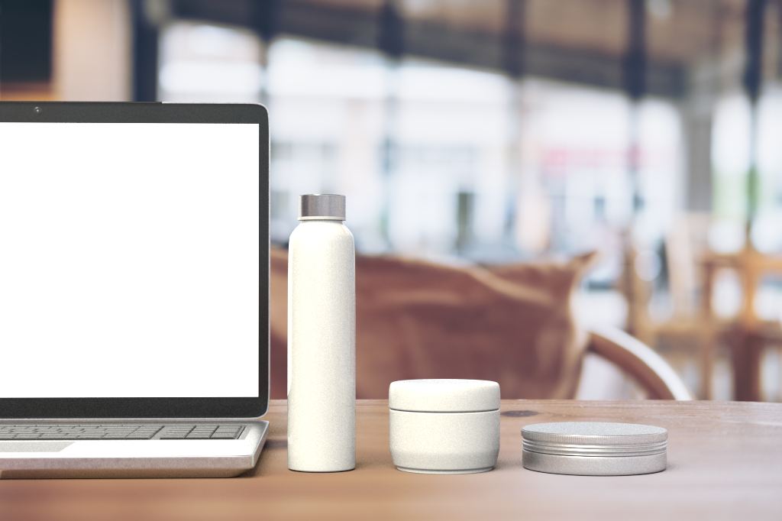
ArtificialShadow
Add a shadow
Before
After

Slide 14
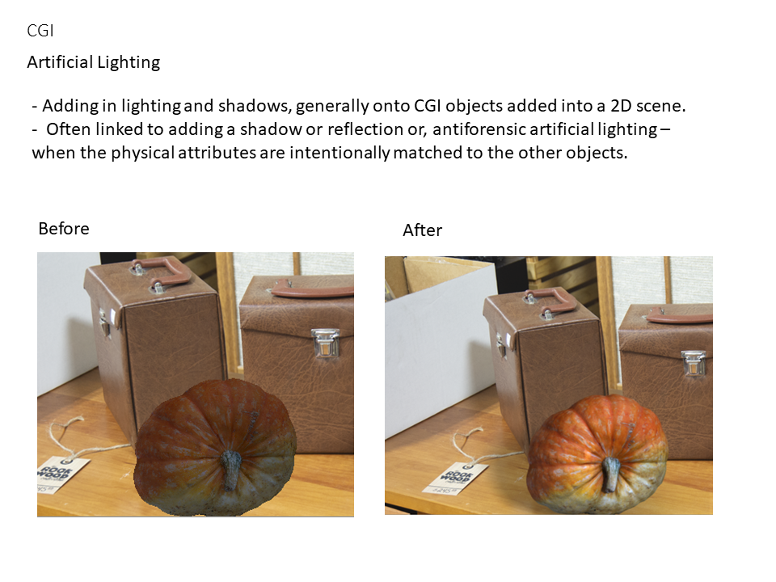
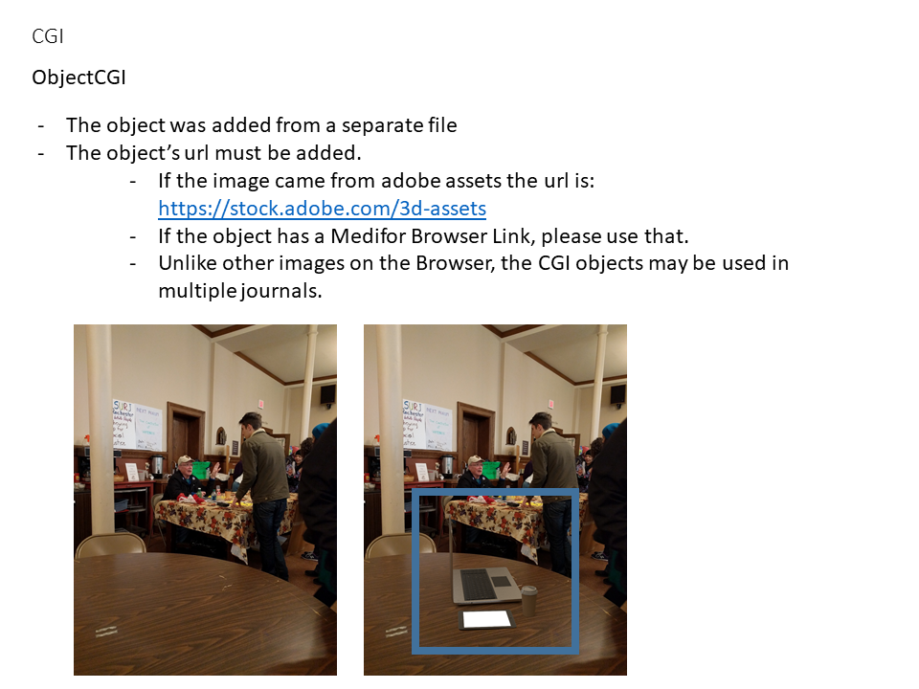
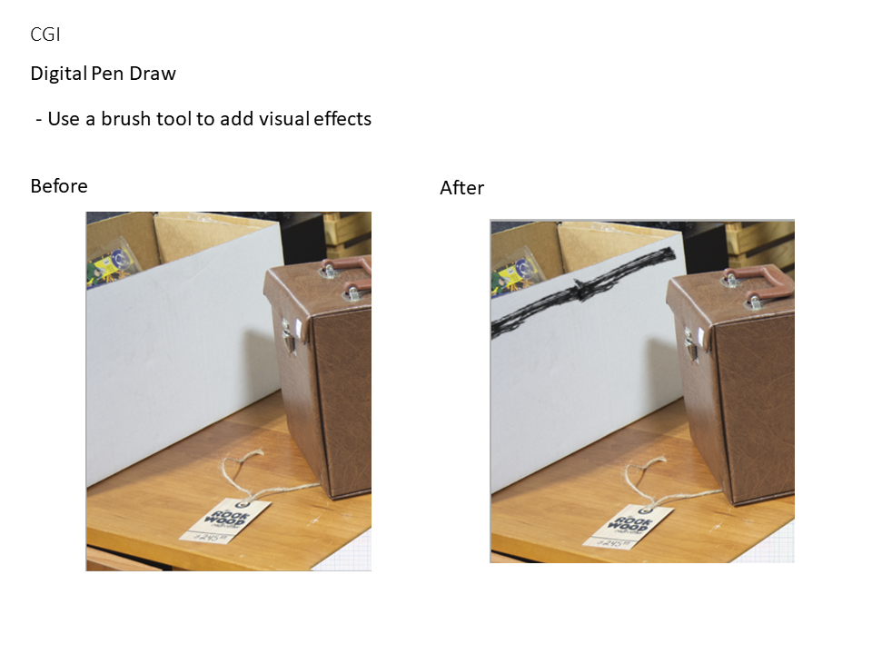
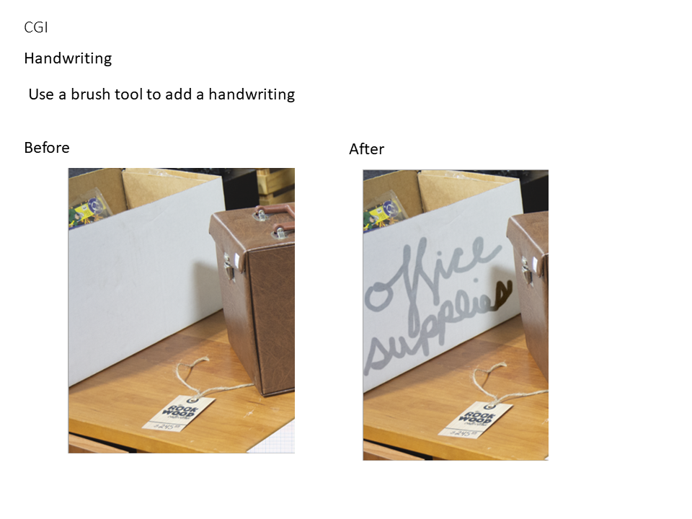
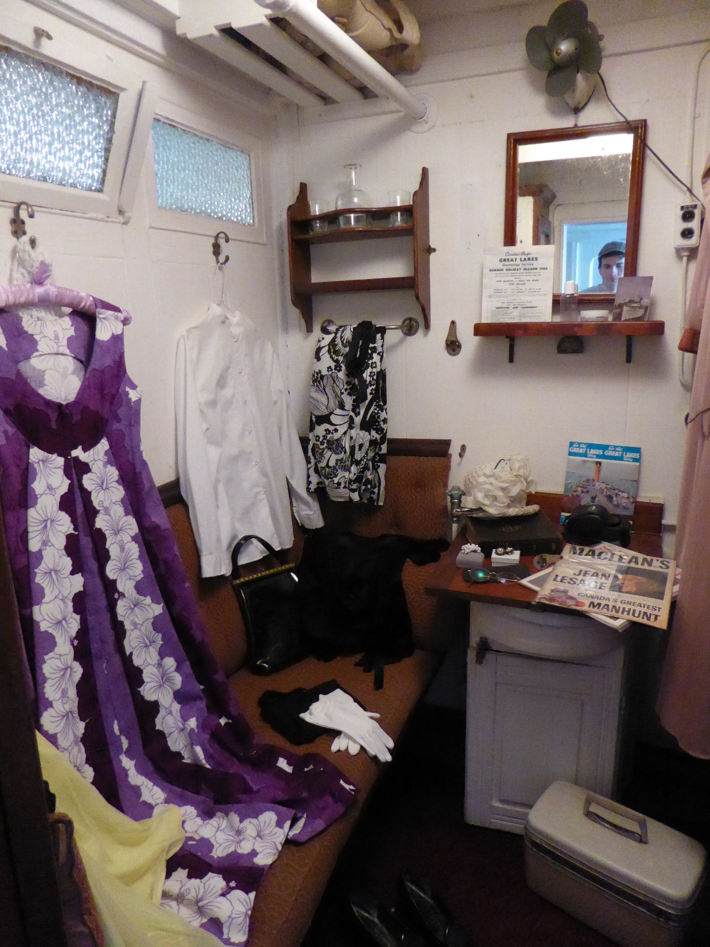

ObjectCGI
ArtificialReflection
ArtificialShadow
ArtificialLighting
Pasted object
Artificial shadow added

Slide 15
DeepFakeFaceSwap
-Face swap with DeepFake Algorithm

Slide 16
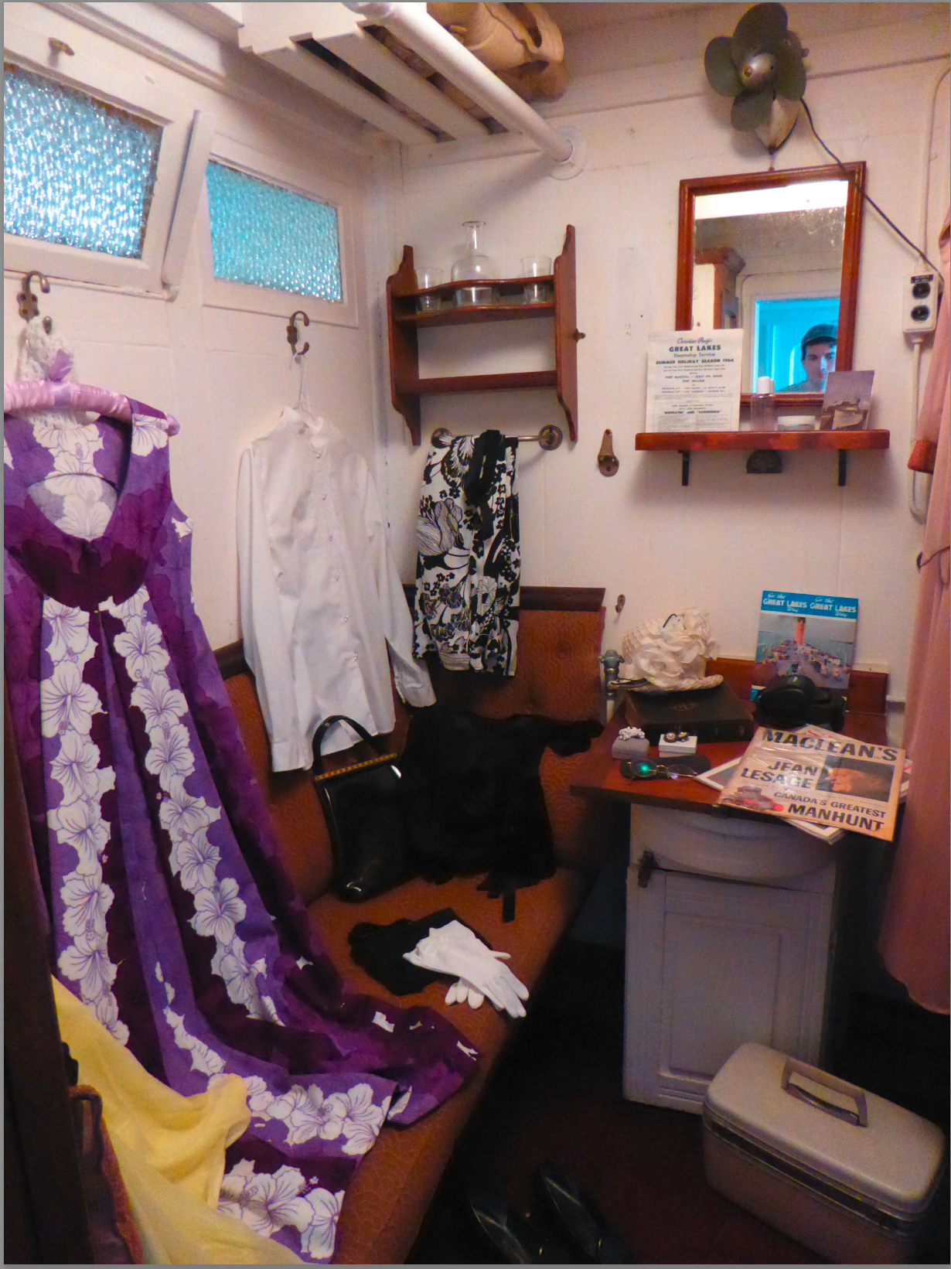
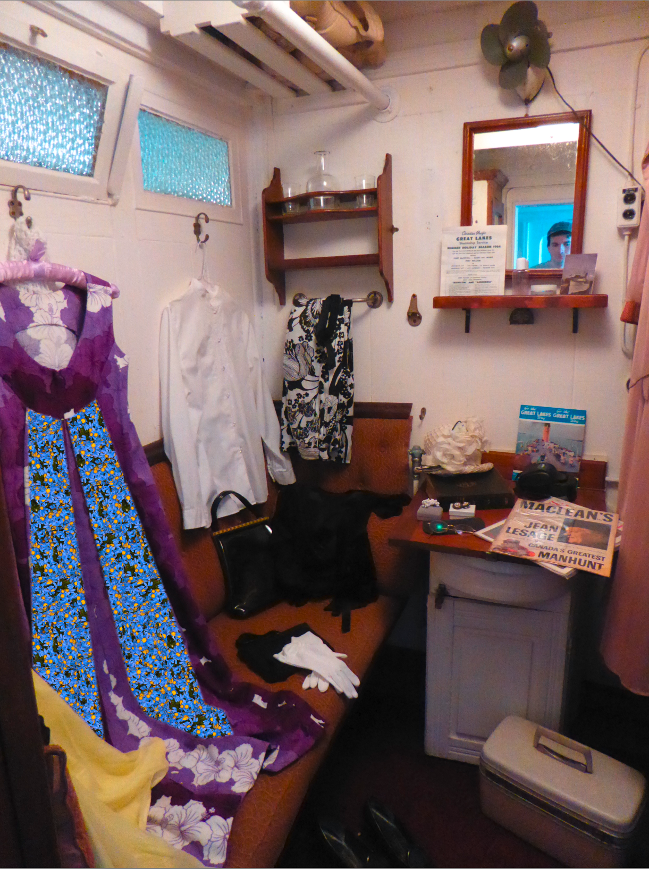
CGIFill
Pattern:
Fill an area with a CGI Pattern
original
with pattern

Slide 17

CGIFill
Fill uniform color is used to make a solid color area in an image.
original
Fill

Slide 18
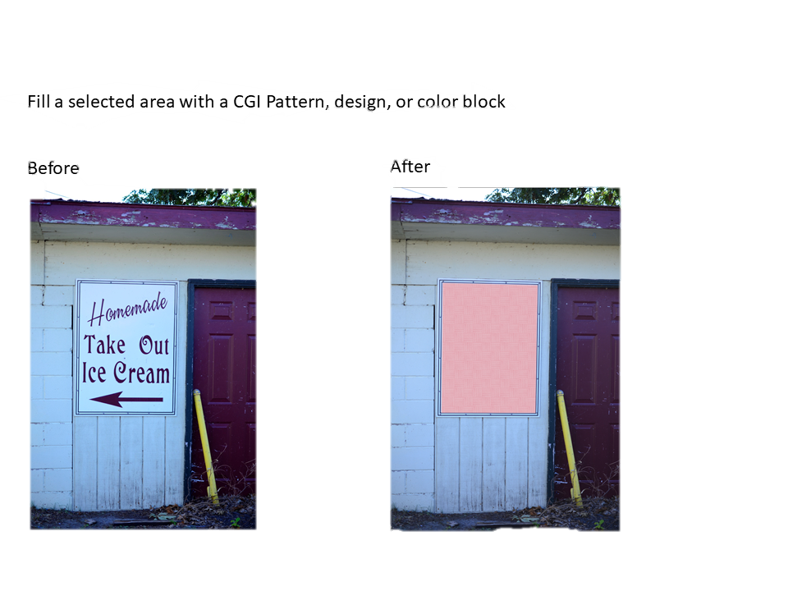
CGIFill

Slide 19
SynthesizeGAN
- Synthesize an image using a trained GAN model and provided input

Slide 20
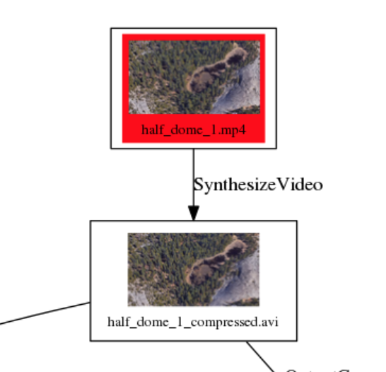
SynthesizeVideo
-Synthesize a video scene using a trained GAN model and provided input.
The video is typically a base or donor node.

Slide 21
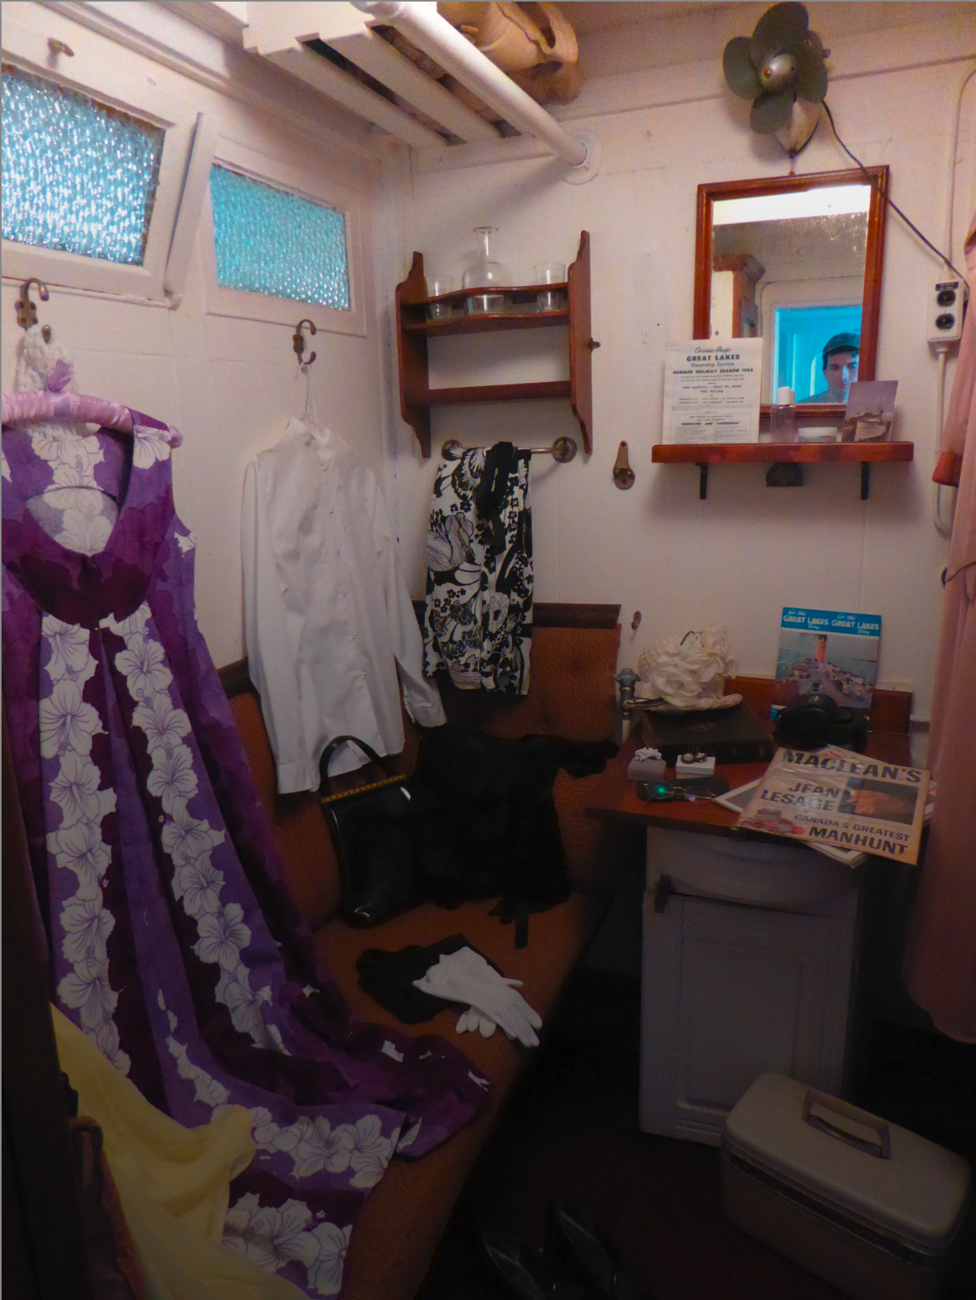
Gradient
Add Gradient on top of an image
A gradient CGI was added over the image to gradually darken the image
original
with gradient

Slide 22
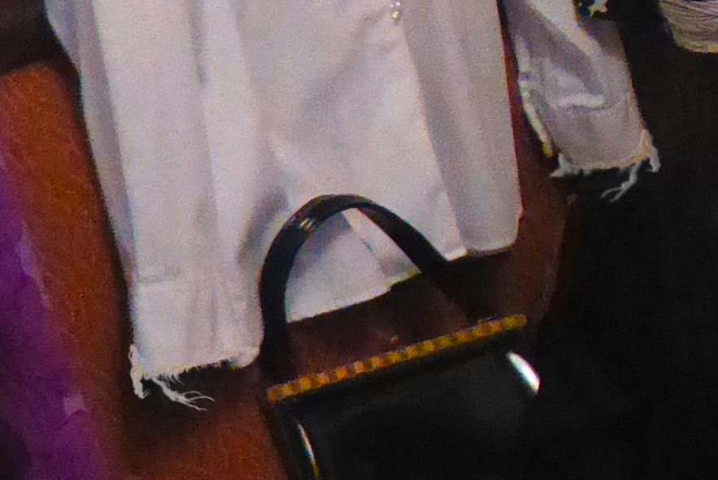
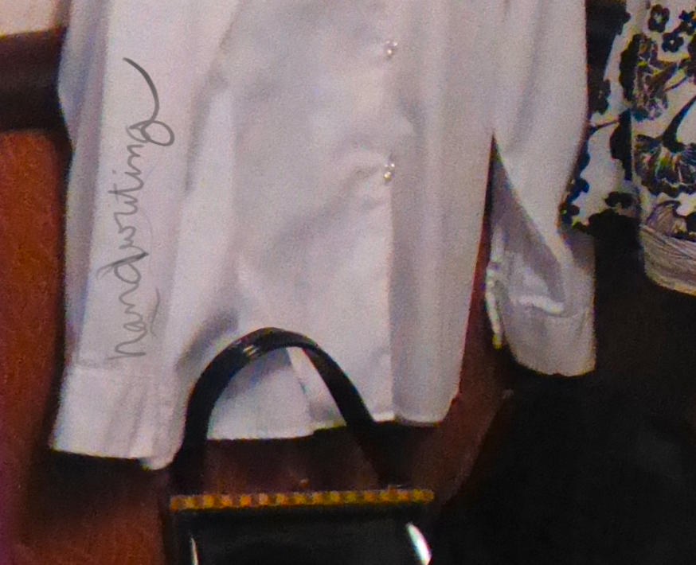
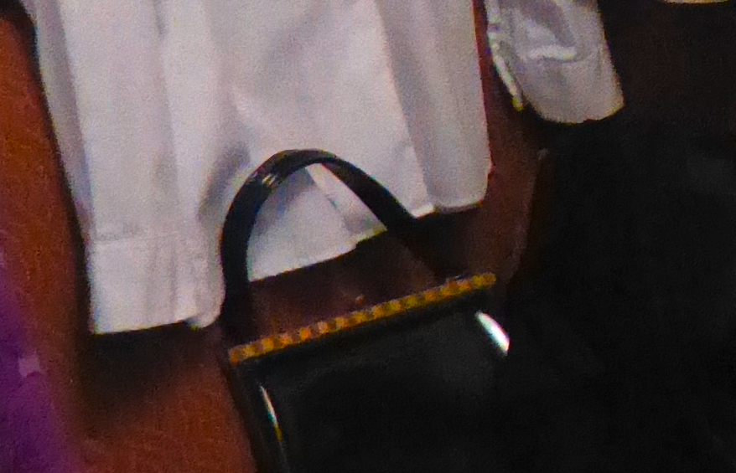
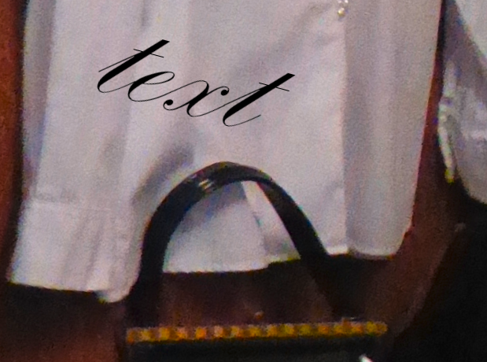
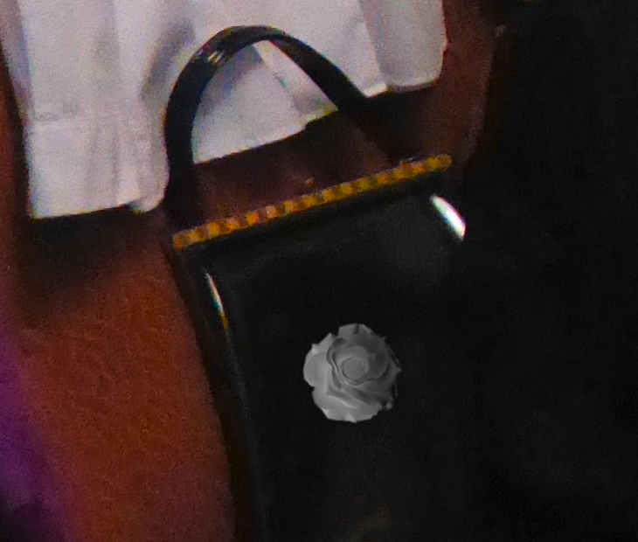
CGI
DigitalPenDraw
Handwriting
OverlayObject
OverlayText
Handwriting
DigitalPenDraw
OverlayText
Original
OverlayObject

Slide 23
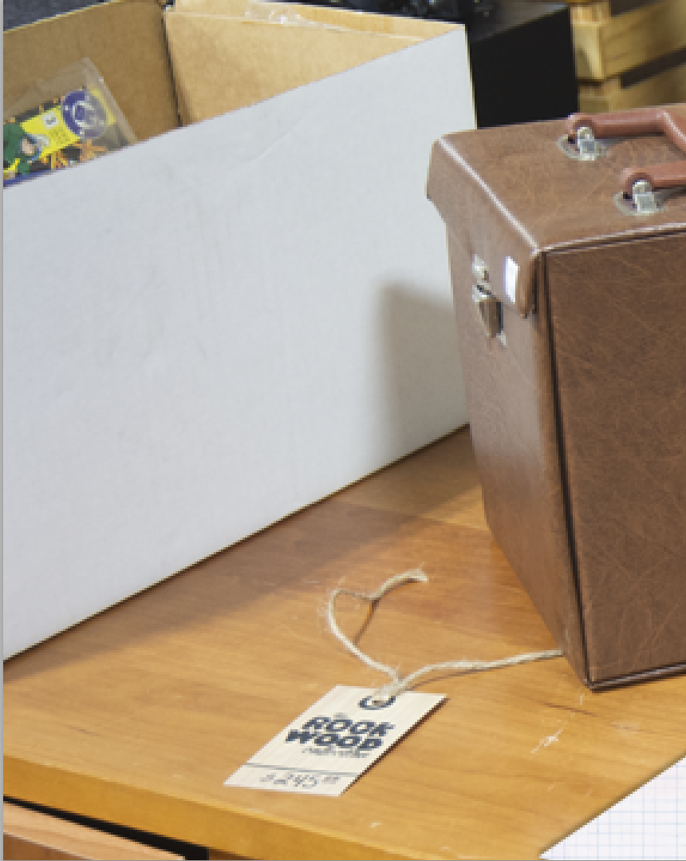
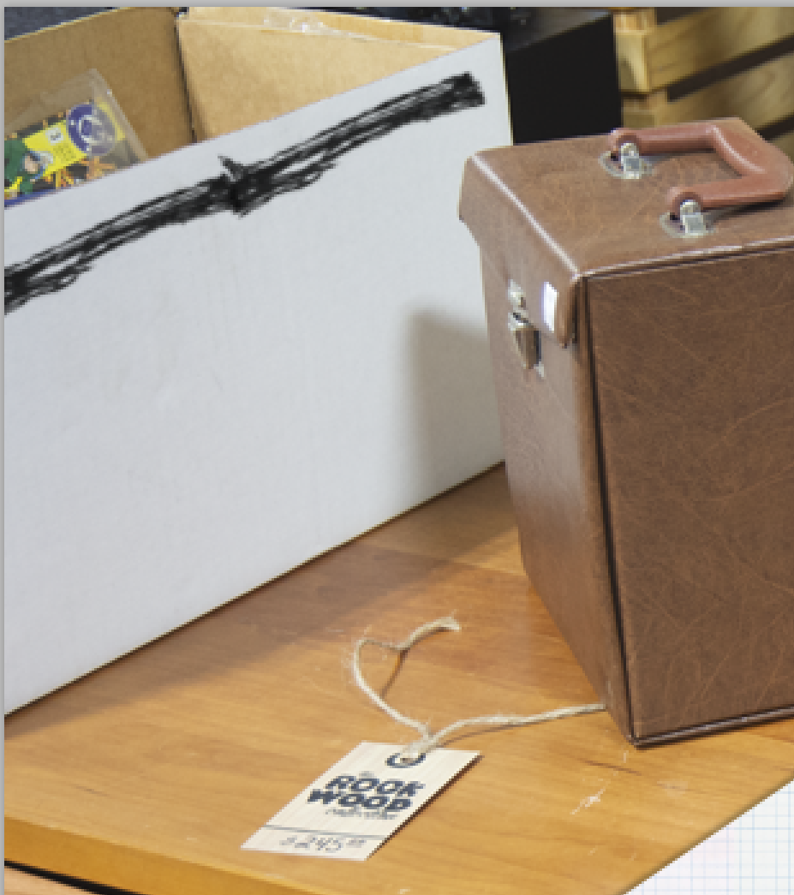
DigitalPenDraw
- Use a brush tool to add visual effects
Before
After

Slide 24
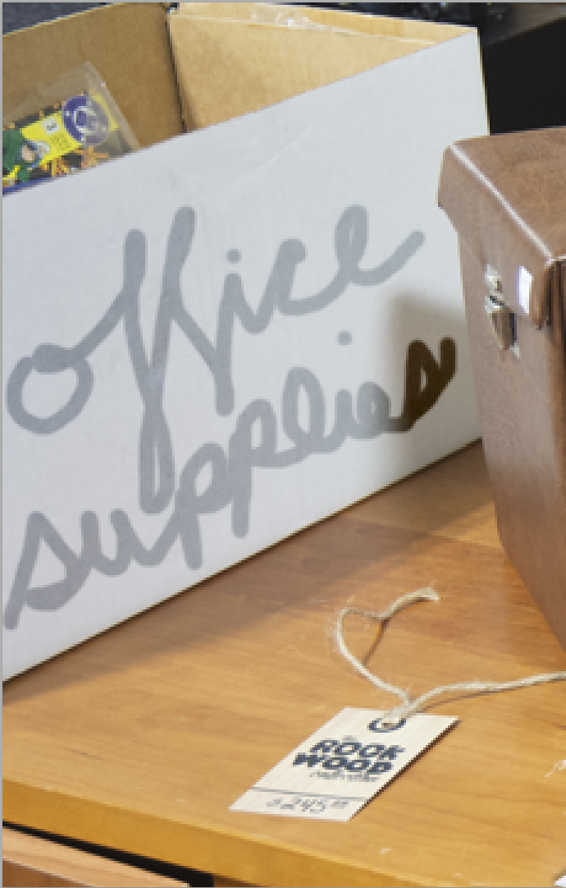
Handwriting
- Use a brush tool to add a handwriting
Before
After

Slide 25
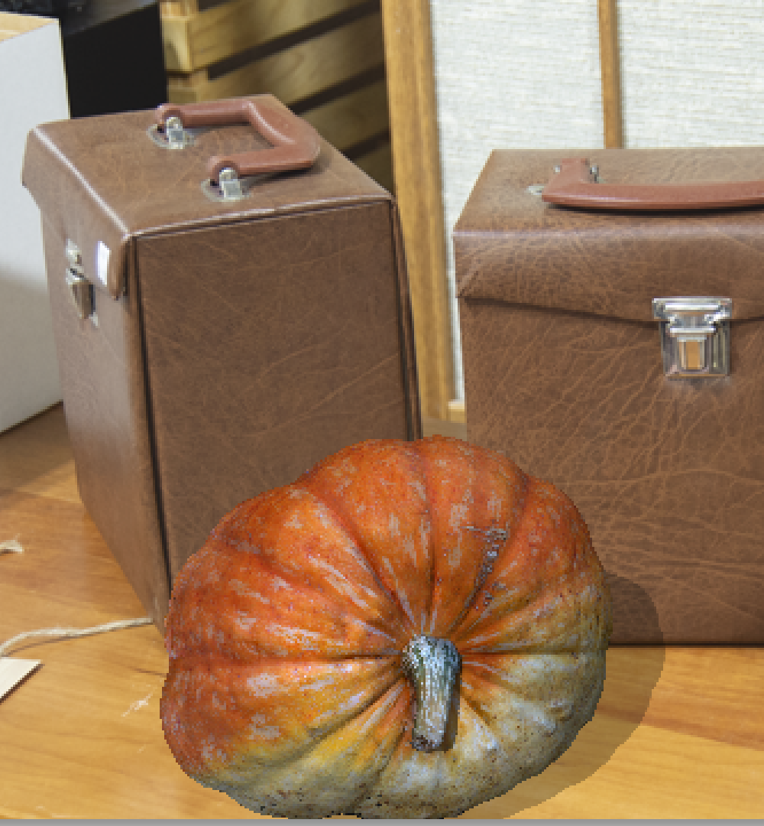
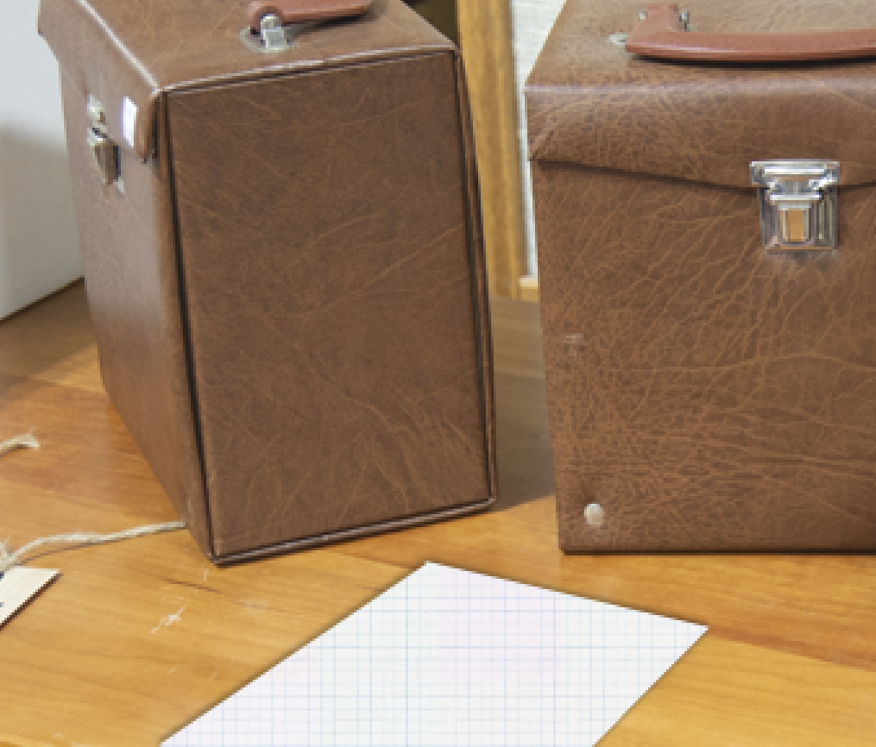
OverlayObject
Add a CGI element to a scene that is not a CGI object such as the fake piece of graph paper added below that was created by filling in an area with a pattern and adding a drop shadow.
The object was created and would not work as a model in other journals.
NOT OVERLAY OBJECT
Overlay Object

Slide 26
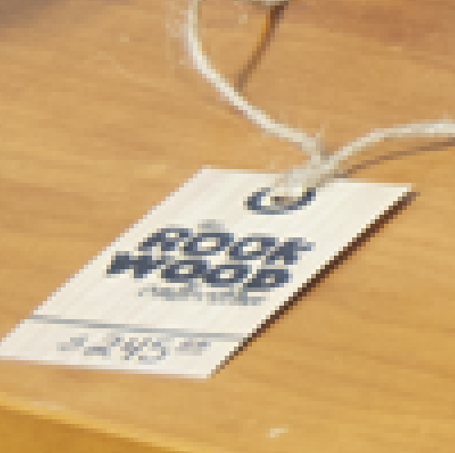
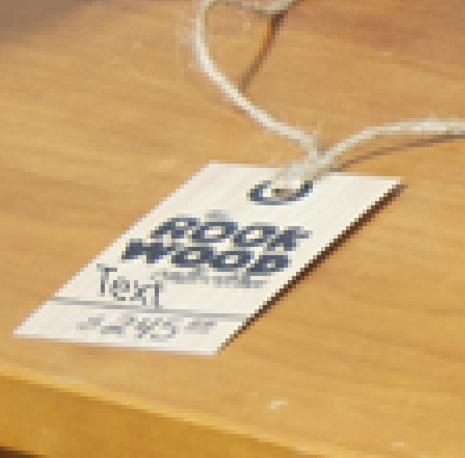
OverlayText
Add Text to an image
Before
After

Slide 27
Color
Operation Name | Description
ColorBalance | Alter the Color Temperature of an image on a Yellow Blue Scale.
ColorInterpolation->ColorLUT | Fill of transparent areas of a current layer with a smooth mix of the colors from the opaque areas. Changing color space or adding LUT
Hue | Alter the color of a selection or image without adjusting saturation or luminance.
Saturation | Alter the color intensity of a given hue.
Vibrance | Visually change brightness and saturation

Slide 28
Color
Vibrance
Hue
ColorBalance
ColorLUT
ColorInterpolation
Saturation
Increase brightness
Increase vibrance
(brightness + saturation)
Increase saturation
Hue change
Decrease brightness

Slide 29
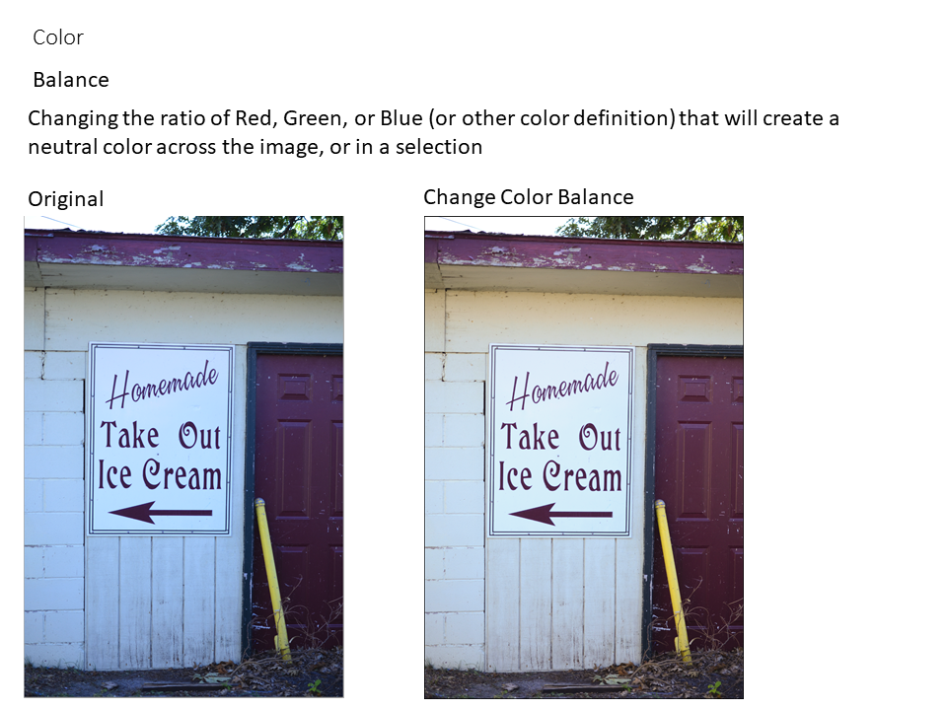
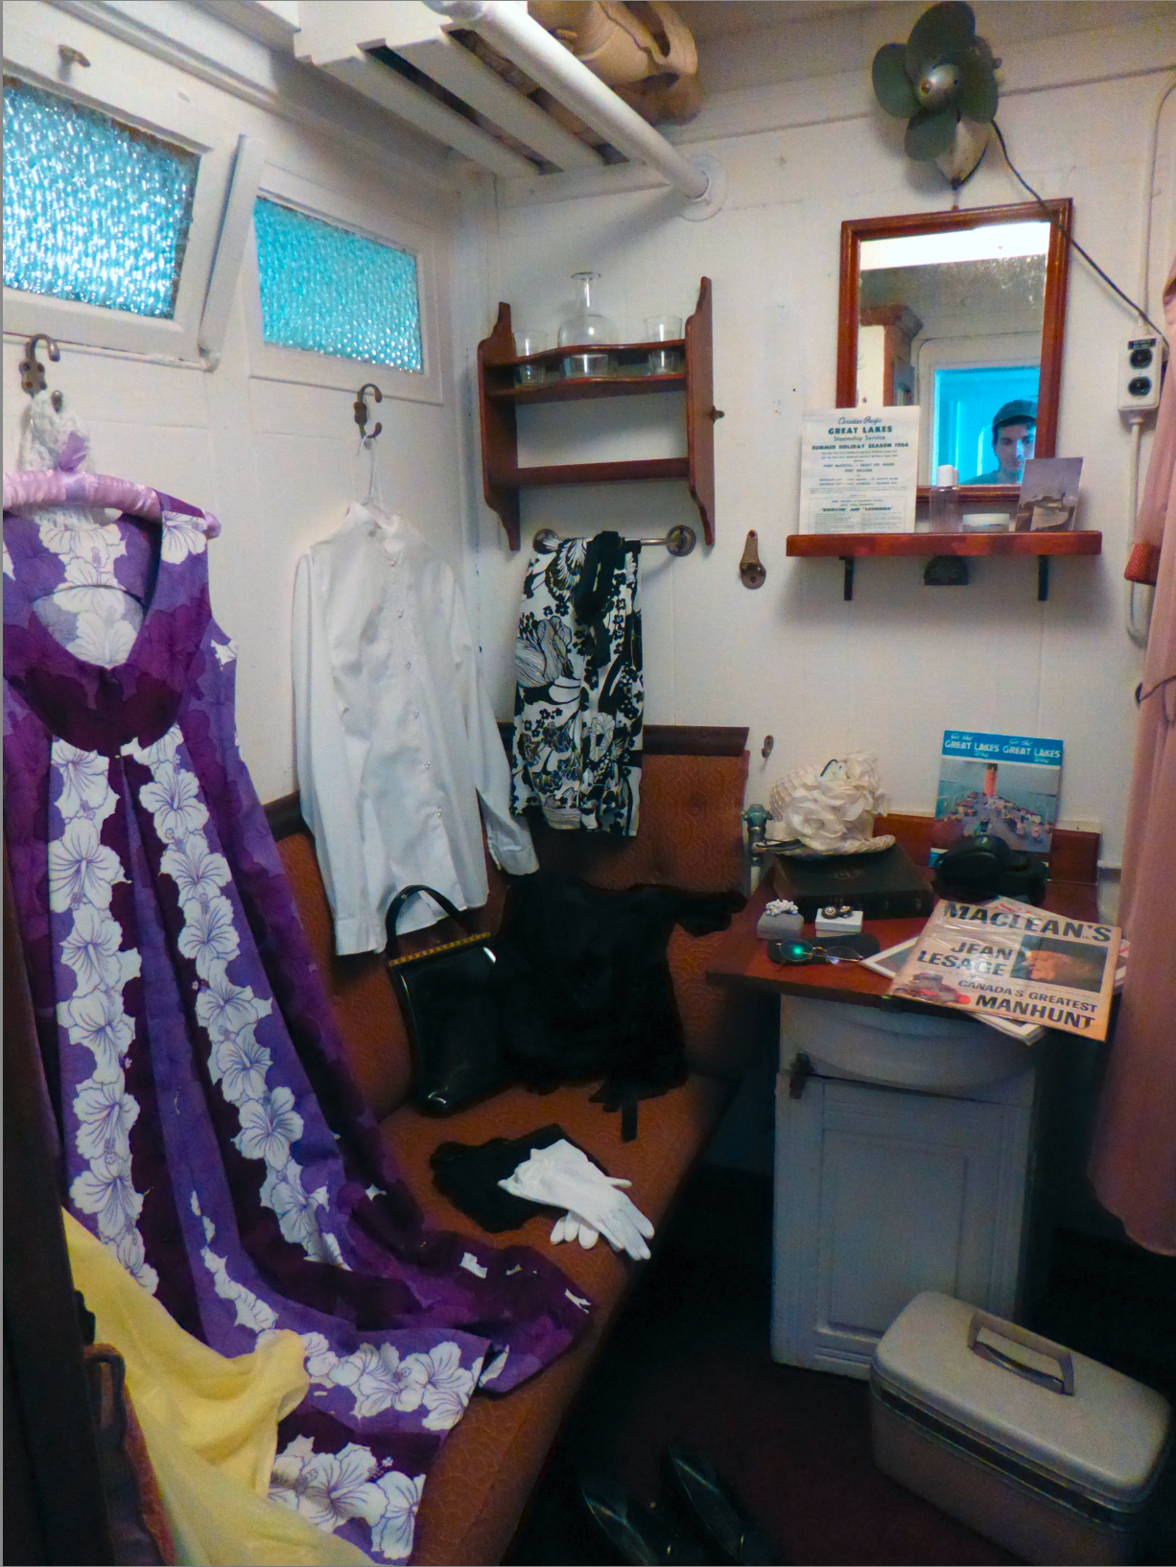
ColorBalance
Color Balance can be done using many different tools, such as curves and levels, that have their own operation. If the intent of those tools is to do color balance, mark the link as Color Balance.
original
Color balance

Slide 30
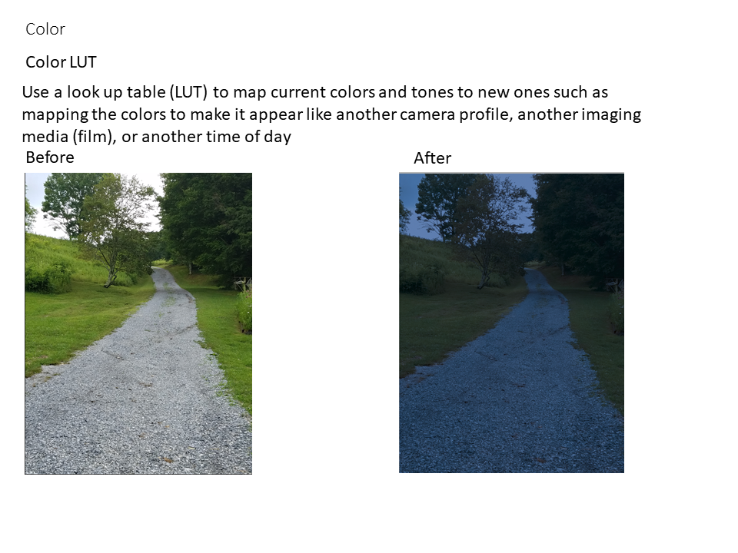
ColorLUT
Color Balance can be done using many different tools, such as curves and levels, that have their own operation. If the intent of those tools is to do color balance, mark the link as Color Balance.
original
Color balance

Slide 31
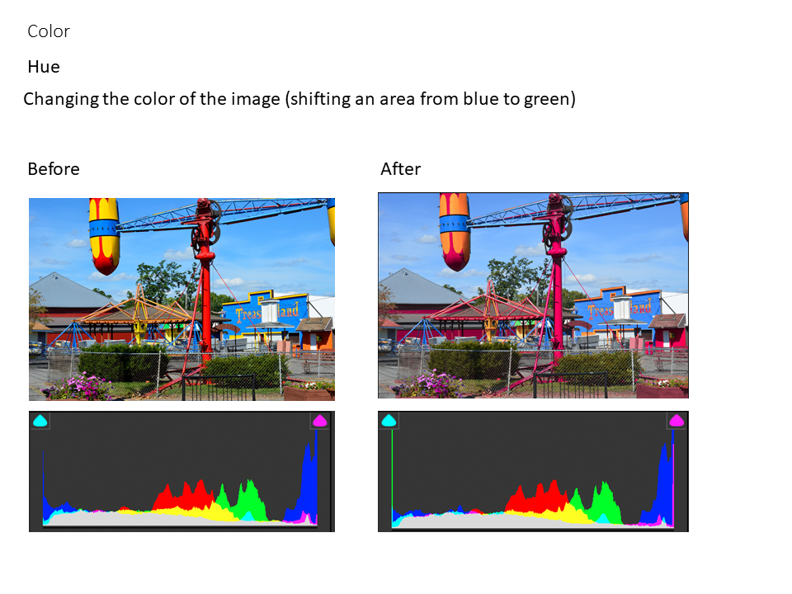
Hue

Slide 32
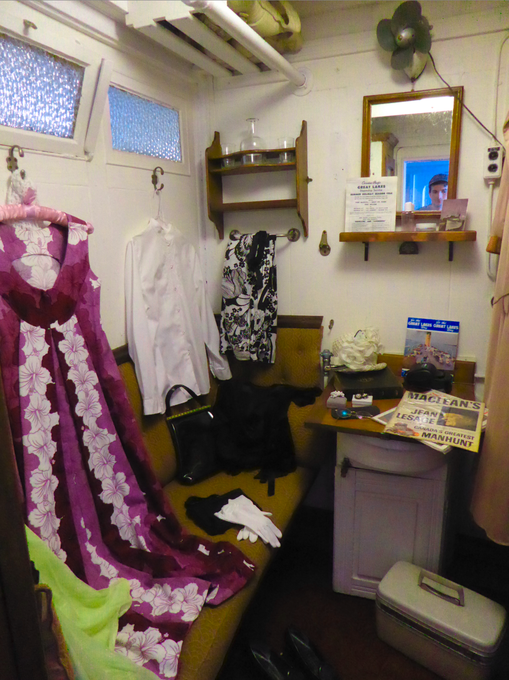
Hue
Hue changes the name of the color that is referred to.
In the images below, the yellows have been shifted to appear more green.
original
Hue shift

Slide 33
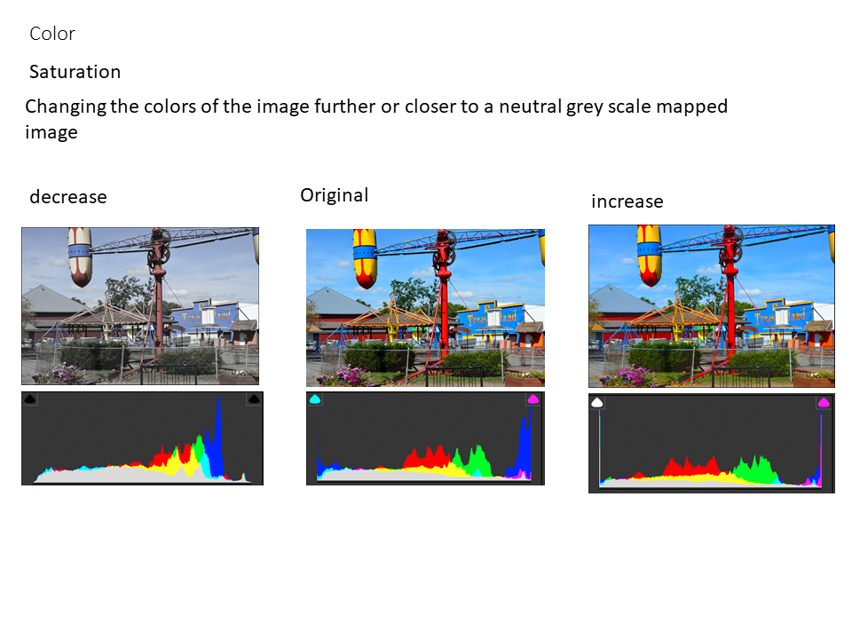
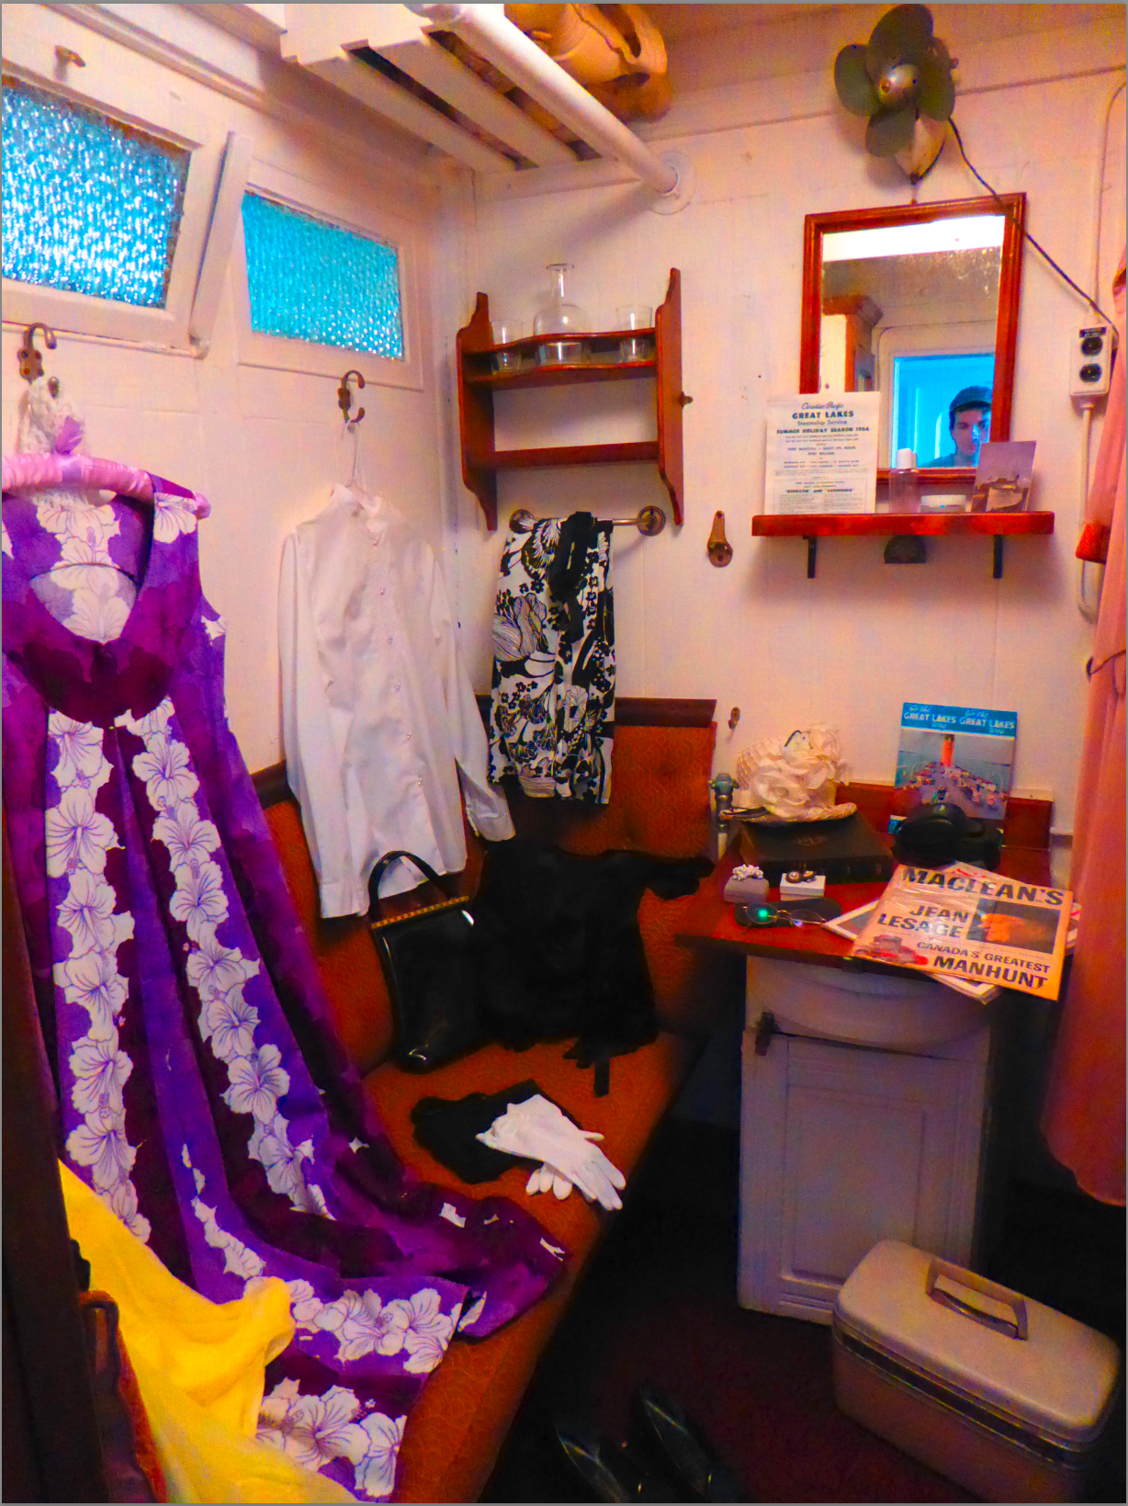
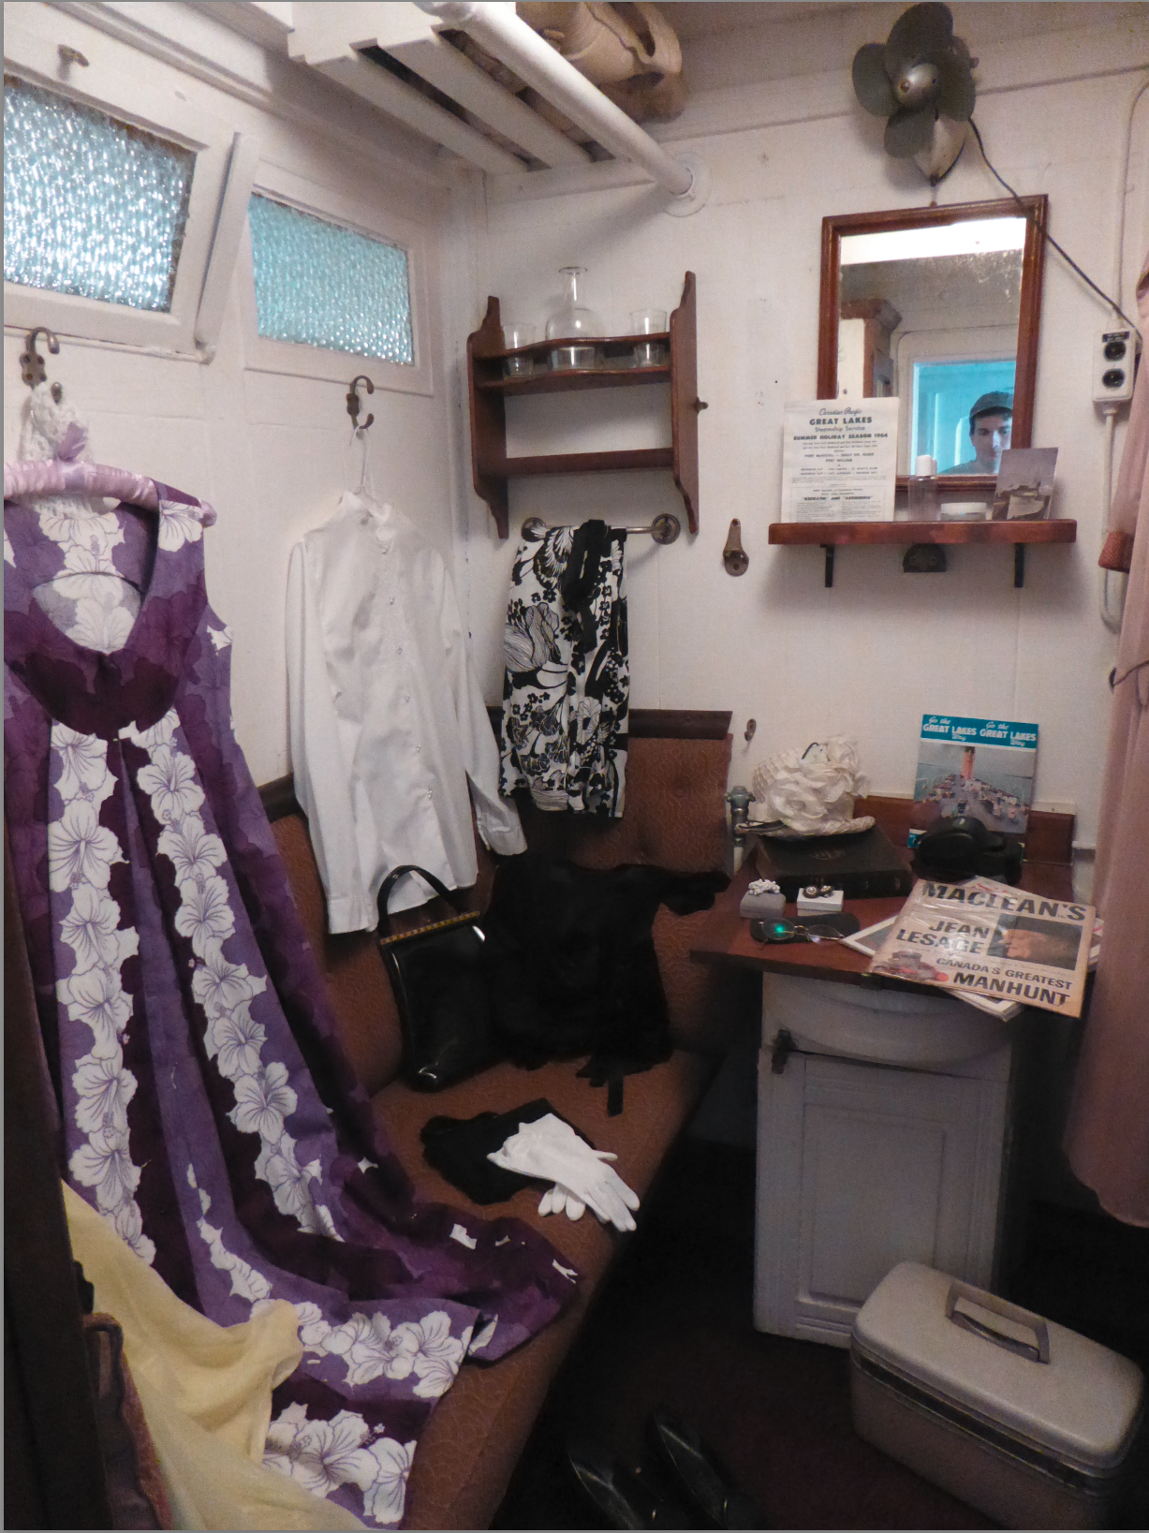
Saturation
original
Saturation increase
Saturation decrease

Slide 34
Saturation
original
Saturation increase
Saturation decrease

Slide 35
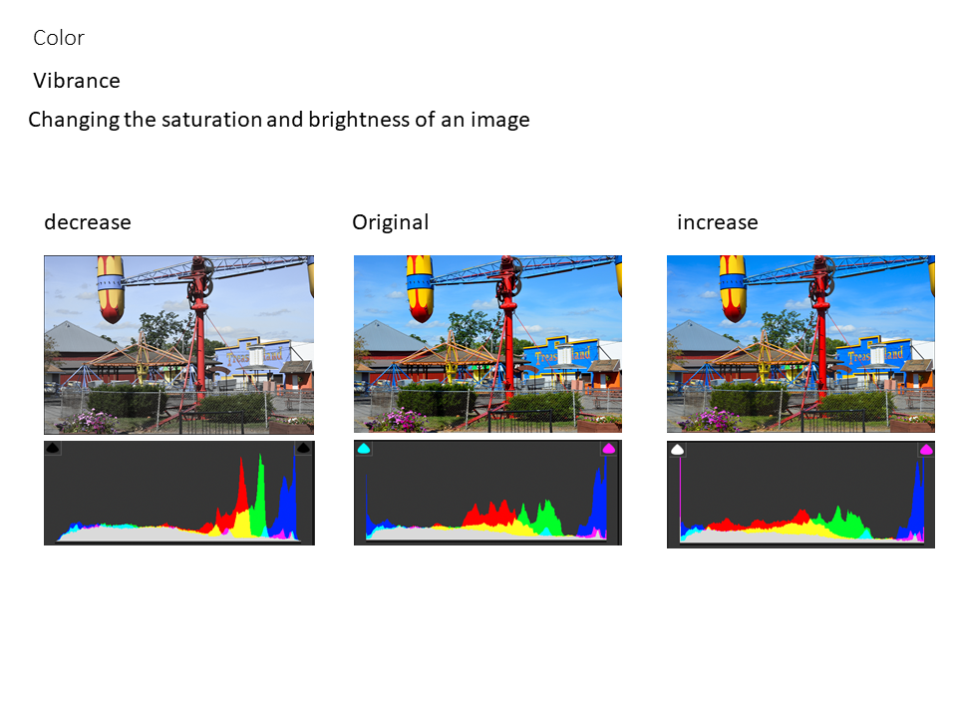
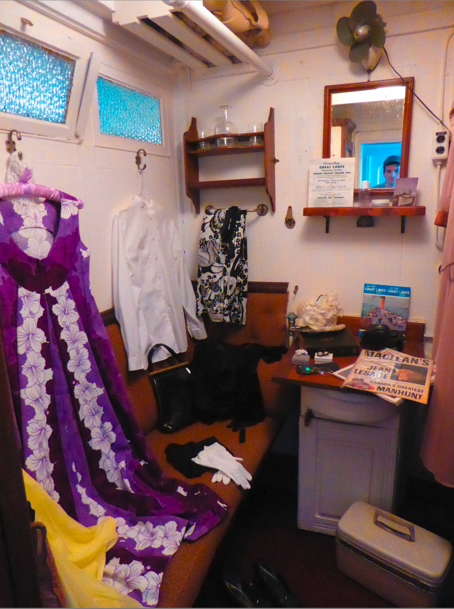
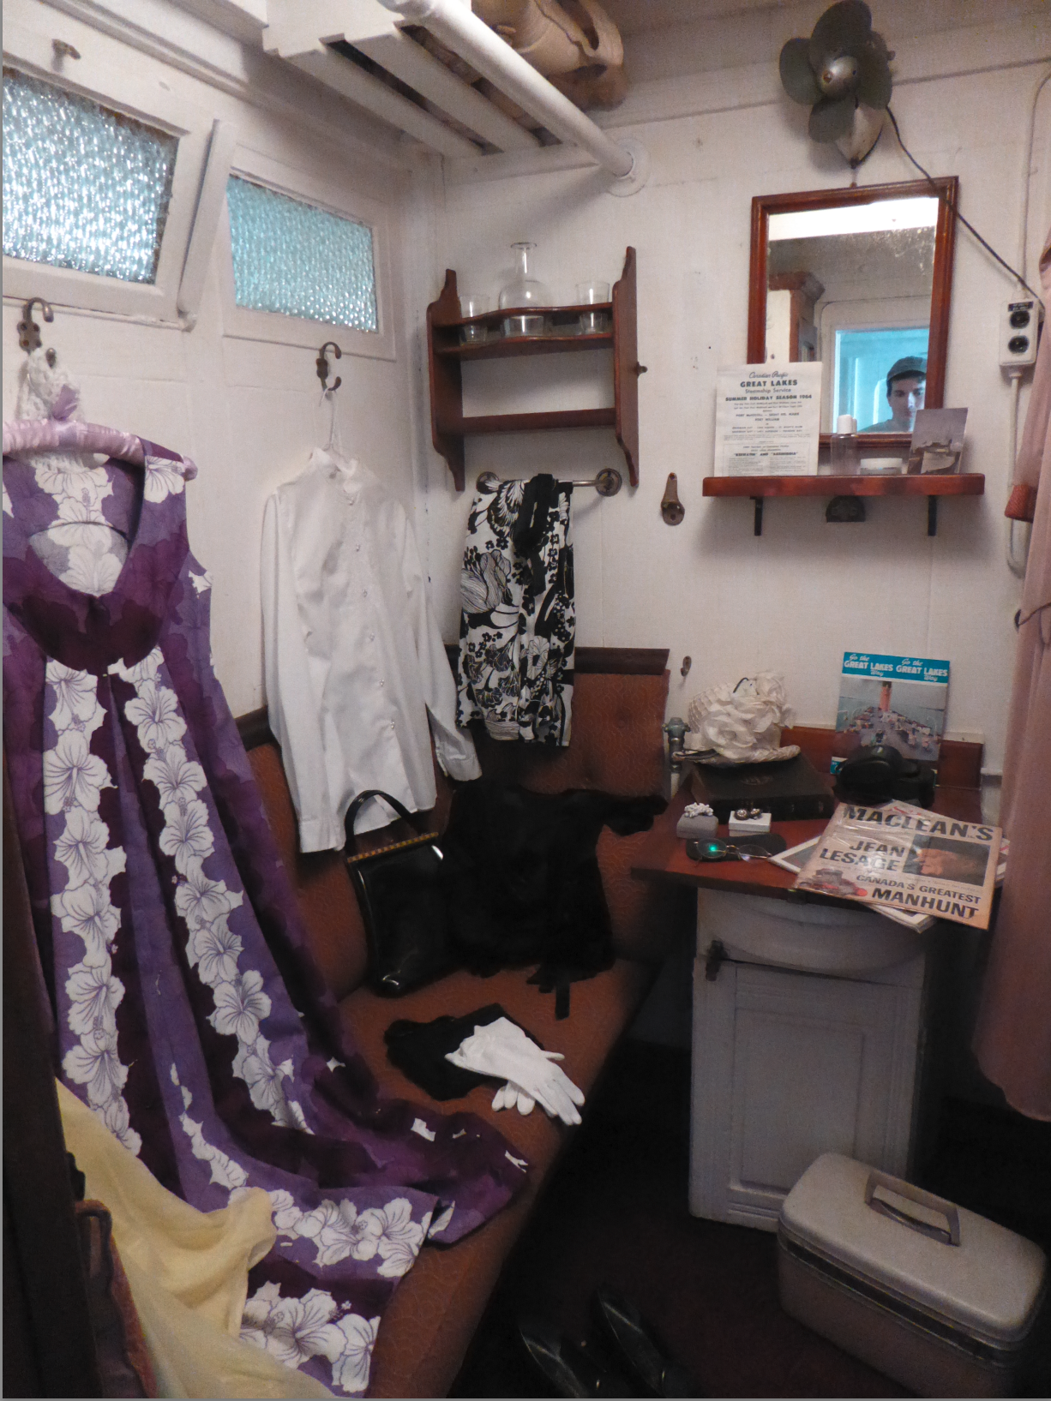
Vibrance
original
Vibrance increase
Vibrance decrease
Vibrance changes both the brightness and the saturation of the colors.

Slide 36
Vibrance
original
Vibrance increase
Vibrance decrease
Vibrance changes both the brightness and the saturation of the colors.

Slide 37
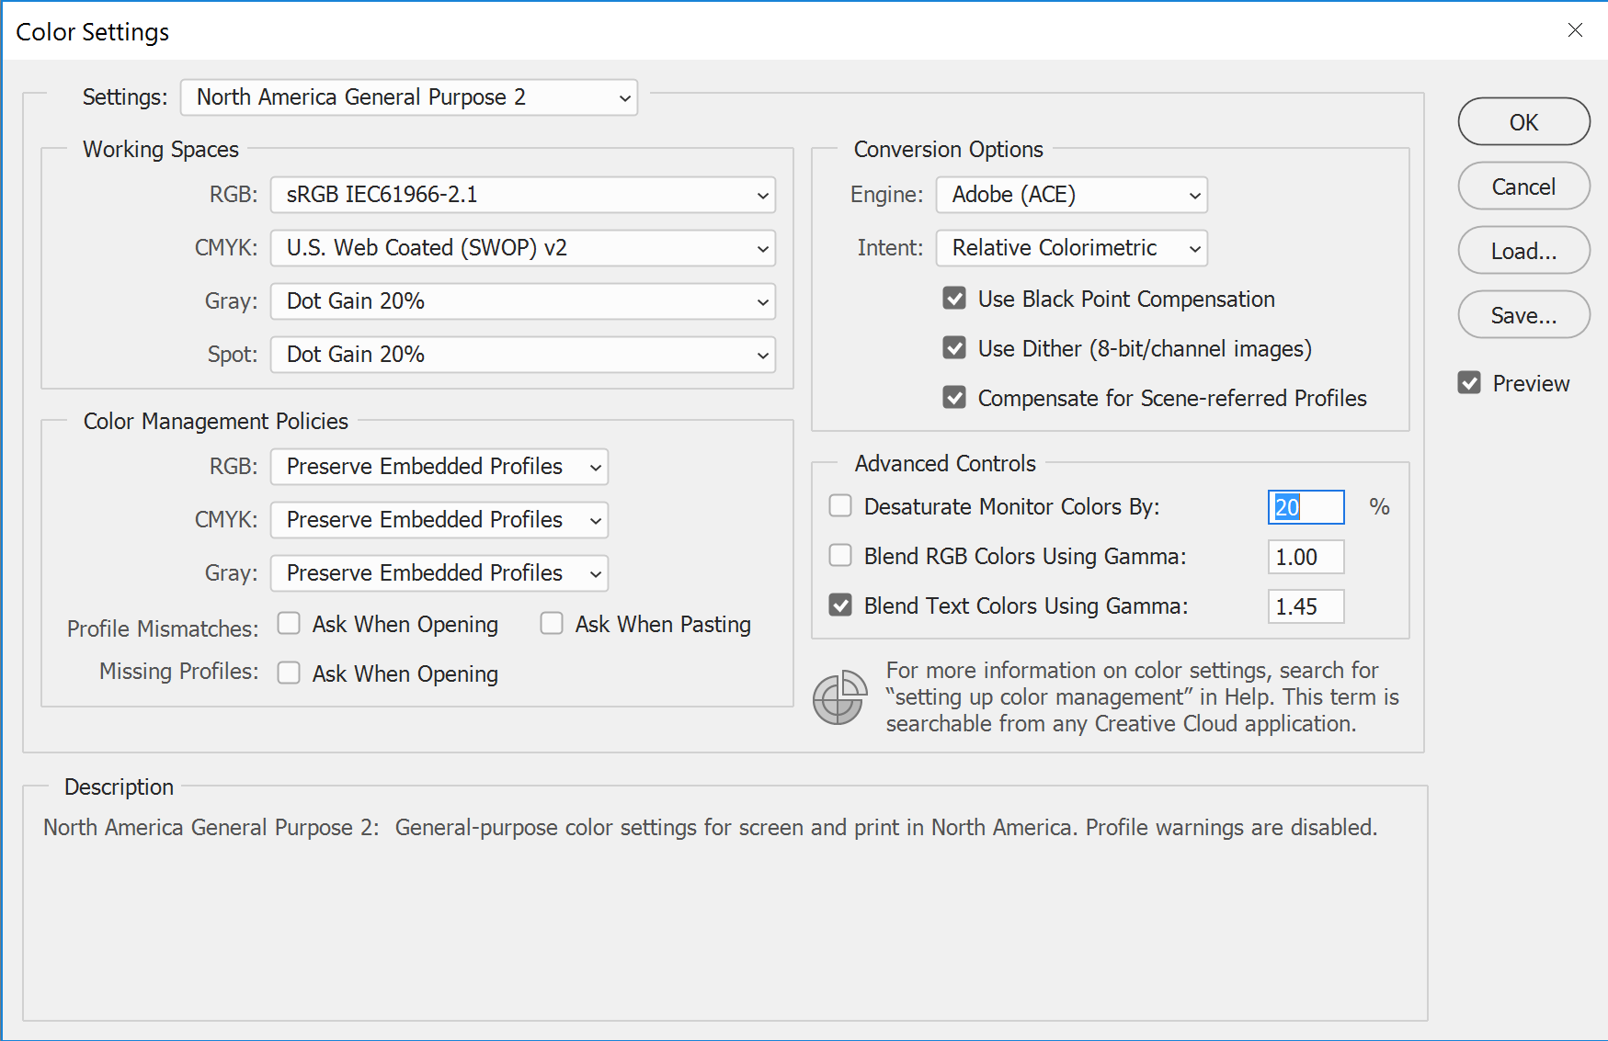
Color
INTERPOLATION:
Color interpolation refers to changing the color space, or the way that the CFA was interpreted by the software. This may or may not result in a very visible change in the image.
This is an example of the different settings in Adobe Photoshop that could be changed to constitute an color interpolation link.

Slide 38
Filter
Operation | Description
FilterConvolutionKernel | Convolve an image with a custom convolution kernel
Blur | Make details unclear or less distinct
Sharpening | Enhance edge definition within an image
MotionBlur | Modify an image or image selection to create the illusion of motion
FilterKeying | Remove a color from a layer of video
CreativeFilter | Filter to alter visual impact of the image
AddNoise | Add random variations of brightness or color information

Slide 39
Filter
FilterConvolutionKernel
Blur
Smooth
Wavelet
Median
Median Smoothing
Gaussian
Radial
Tilt Shift
Motion
Other
Sharpening
MotionBlur
FilterKeying
CreativeFilter
AddNoise
Salt-pepper
Shot
Uniform
Random
Gaussian
Periodic
Other

Slide 40
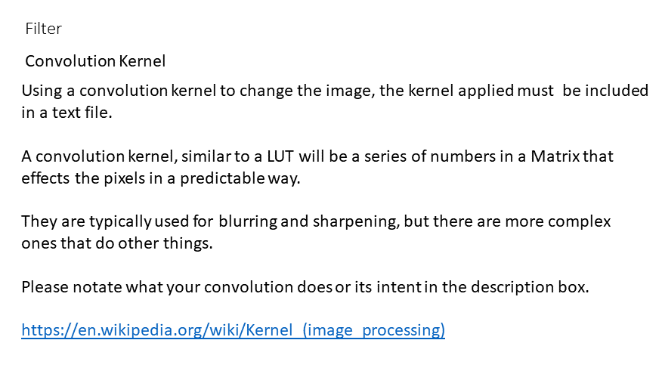
FilterConvolutionKernel
ConvolutionKernel
Blur
Smooth
Wavelet
Median
Median Smoothing
Gaussian
Radial
Tilt Shift
Motion
Other
Sharpening
CameraRawFilter
CreativeFilter
AddNoise
Salt-pepper
Shot
Uniform
Random
Gaussian
Periodic
Other

Slide 41
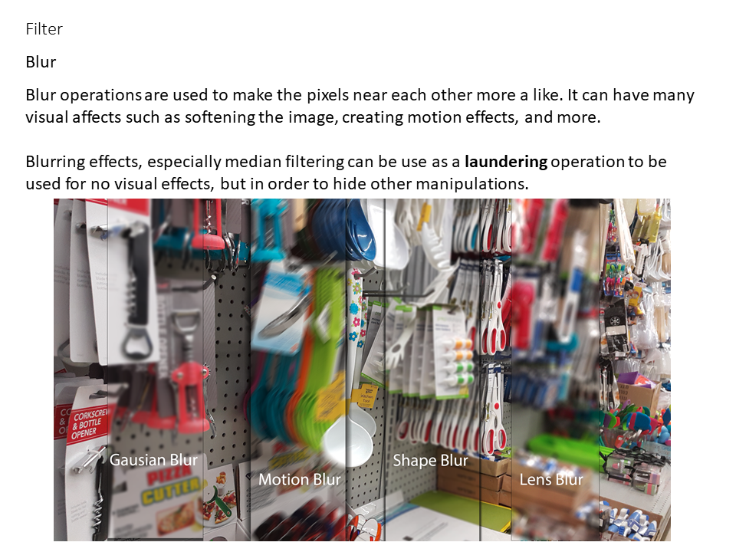
Blur

Slide 42
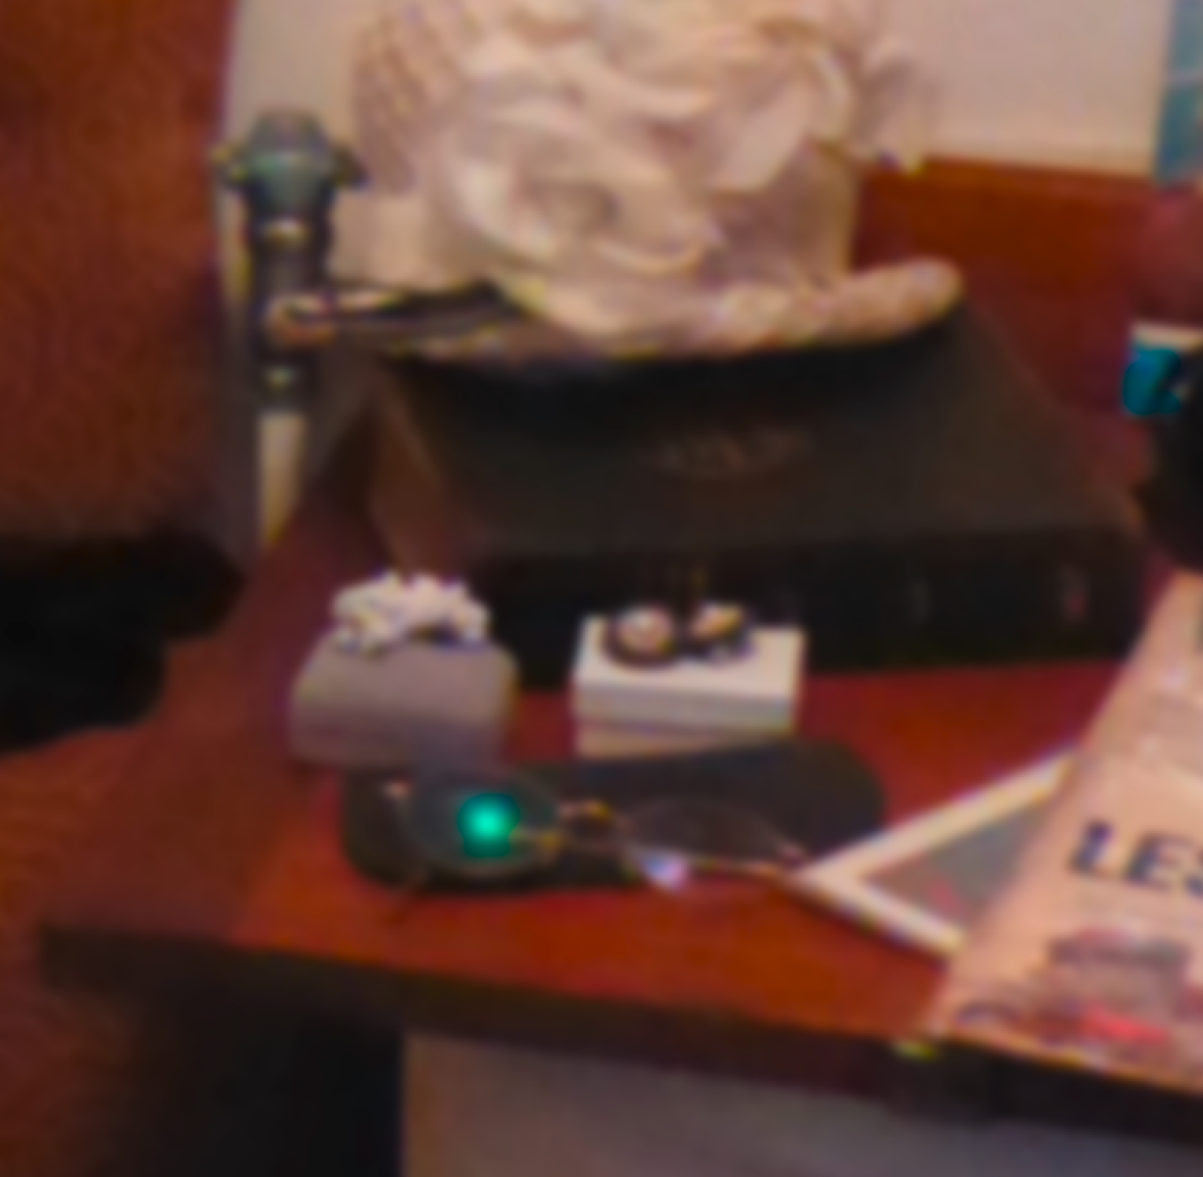
Blur
Blur makes pixels more like each other to create a variety of effects.
Blur should be used for any type of blur other than Motion Blur.
Blur can also be documented more specifically by using Filter Convolution Kernel
original
Blur (Gaussian)

Slide 43
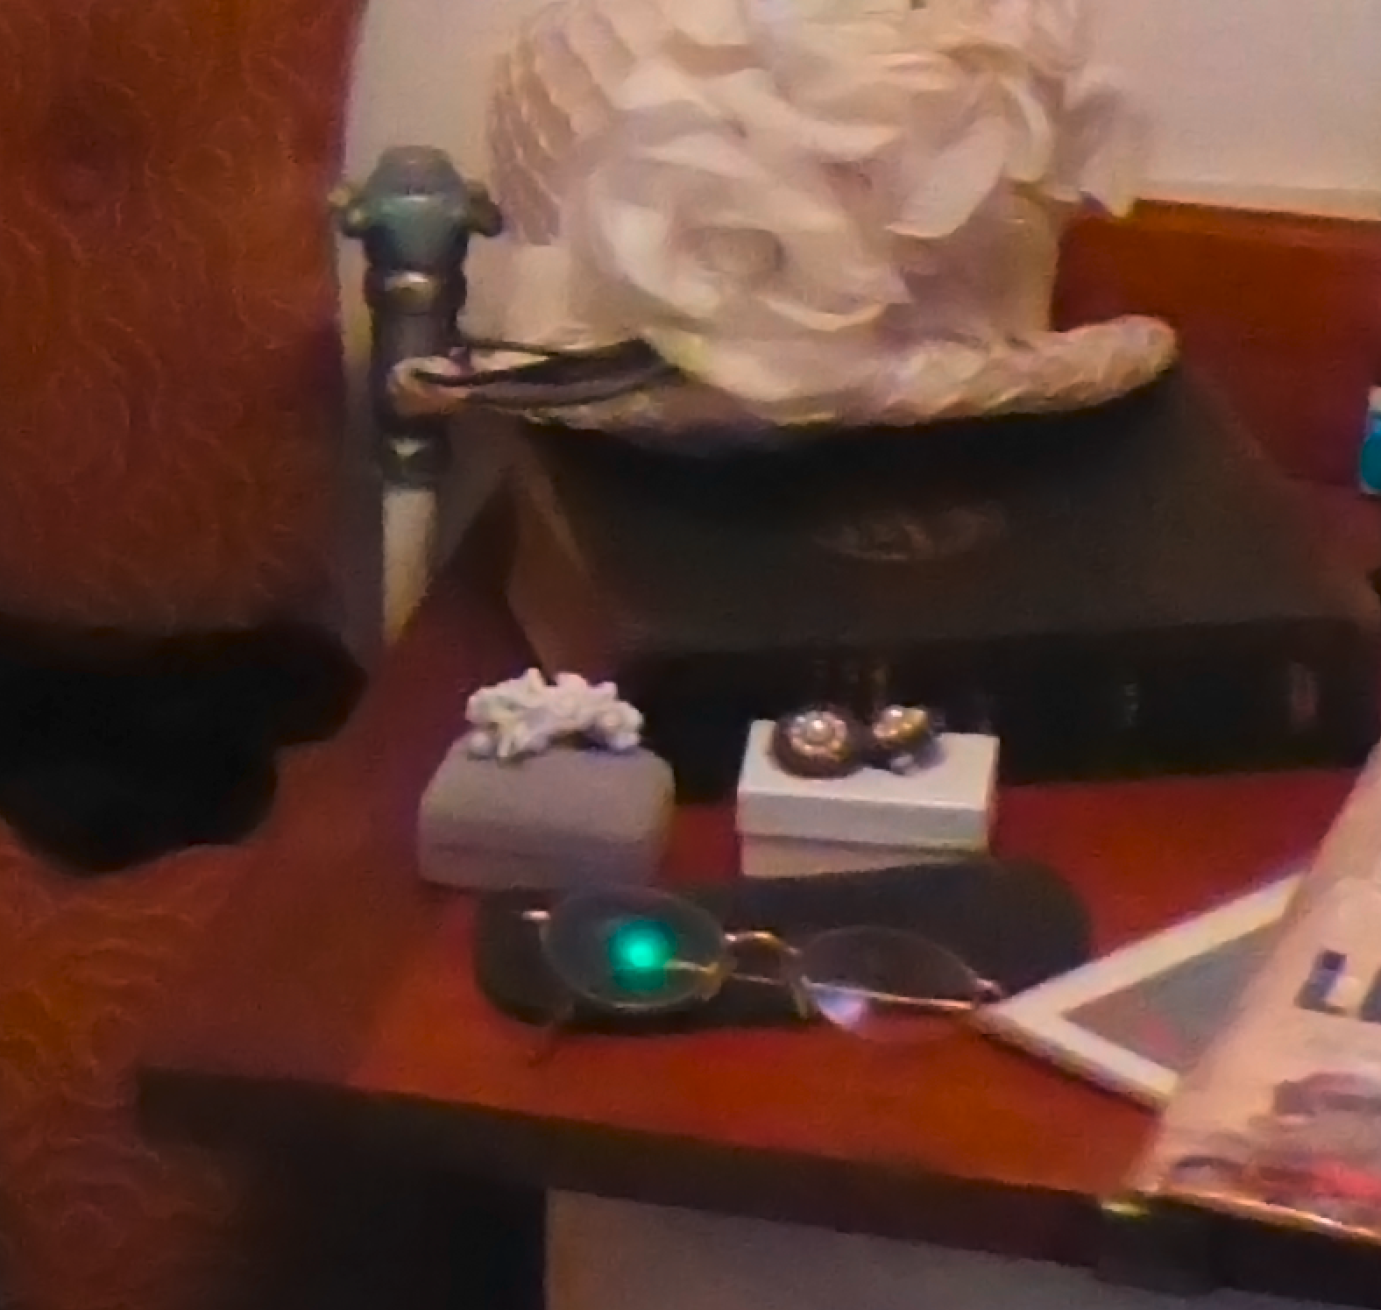
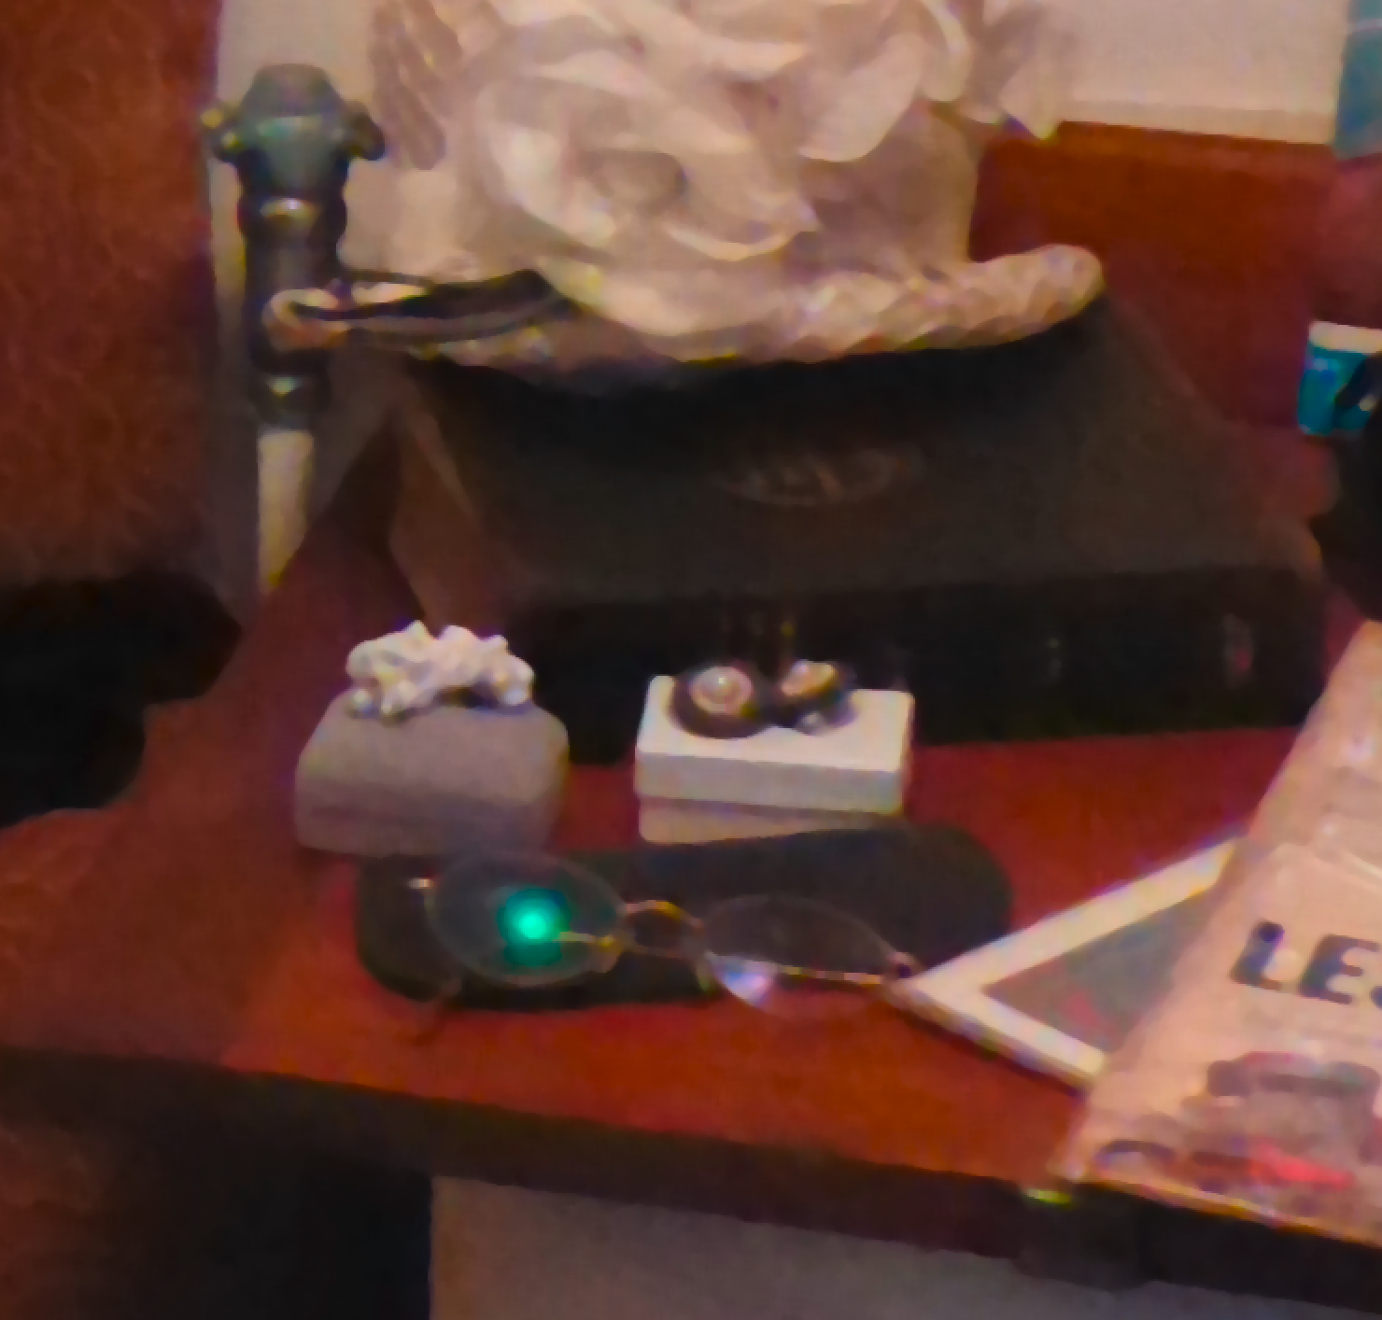
Smoothing and Median Filtering
Blur
Noise reduction
Making neighboring pixels more alike
Median Filtering can be done for laundering purpose
original
Smoothing
Median

Slide 44
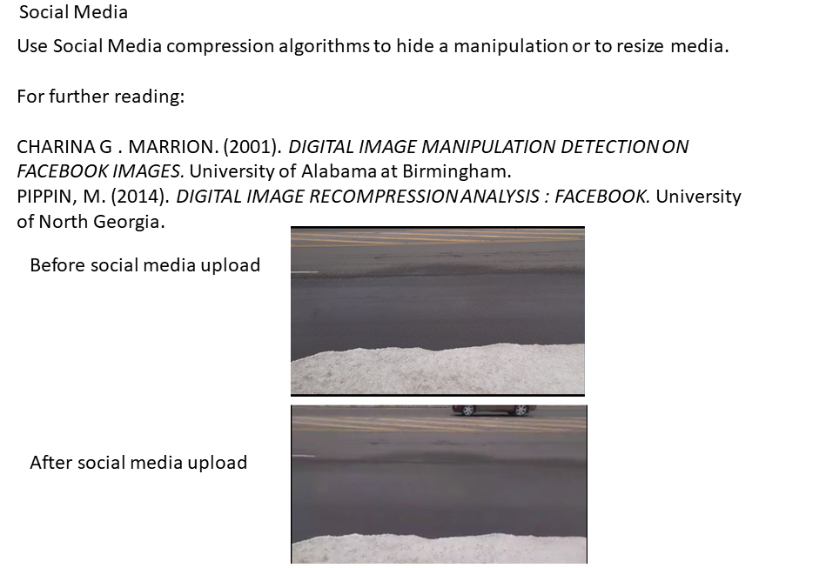
Blur
Laundering

Slide 45

Sharpening

Slide 46

Sharpening
Sharpening makes edges more prominent by creating larger differences between the pixels based on a type of edge detection algorithm
original
Sharpened

Slide 47
CreativeFilter
Filter
Creative Filter
Creative Filter is a catch-all operation that can be used to identify specialty filters that act like black boxes. These filters may do multiple manipulations at once.
IF AT ALL POSSIBLE: use a combination of images for higher granularity
Be sure to include what filter and how it was used in the description area of your Journaling Tool upon connecting this node.
If the CreativeFilter you are using is not one of the options listed to choose from contact your administrator to add a field in parameters if needed.

Slide 48

CreativeFilter
Example:
Original
Oil paint filter

Slide 49

AddNoise

Slide 50

AddNoise
Use Add noise for all noise additions other than PRNU noise
original
Add noise (Gaussian)

Slide 51
Groups
Images
Operation Name | Description
OverlayTextWithResize | A Software/Program doesn’t give you the option but watermarks and resizes a image upon save. Another example is if all you did was to Overlay Text and upon export/save the file gets resized
OutputPNGWithResize | A Software/Program doesn’t give you the option but resizes upon save/export to PNG
CreativeFilterwithResize | A Software/Program doesn’t give you the option but resizes your image upon save even though all you did was apply a Creative Filter
AddAudioFade | A increase or decrease in the level of audio signal: Examples: a audio signal gradually decreasing to zero, gradually increasing to maximum value, or fading out from one clip and into another clip

Slide 52
Intensity
Operation Name | Description
Normalization | Normalize using histograms.
Contrast | Shift luminance values on a histogram where higher values become higher and lower values become lower.
Curves | Shift luminance values on a histogram with an editable and flexible curve.
Exposure | Shift all luminance values on a histogram to higher or lower values.
Levels | Adjust brightness, contrast, and tonal range by specifying the location of complete black, complete white, and midtones in a histogram.
Luminosity | Alter the values of a luminance histogram.

Slide 53

Normalization

Slide 54


Contrast
When you change the relationship between the intensity of the pixels.
Increase contrast: creates larger differences between the brightest and darkest pixels.
Decrease contrast: creates smaller differences between the brightest and darkest pixels.
Contrast -decrease
original
Contrast - increase

Slide 55



Curves
Original
Auto Curves

Slide 56

Curves

Slide 57

Exposure

Slide 58


Exposure
Mimics the result of adding more or less light in Exposure Values in capture.
Exposure -decrease
original
Exposure - increase

Slide 59

Levels

Slide 60

Levels
Levels & Curves - Histograms
By changing the histogram in the separate channels, not only the intensity can be adjusted, but the color will be shifted as well.
See journal for examples of curves and levels: https://medifor.rankone.io/journal/3478
Color Characteristics
0 - black
255- white
0 - cyan
255- red
0 - magenta
255- green
0 - yellow
255- blue

Slide 61

Luminosity

Slide 62
Layer
Operation Name | Description
LayerOpacity | Change the transparency of a given color overlay.
LayerFill | Change the fill using a solid color or gradient.
Blend | Edit or paint each pixel to make it the result color. The result color is a random replacement of the pixels with the base color or the blend color, depending on the opacity at any pixel location. FOR VIDEO JOURNALS
LayerStacking | Combining layers in a mathematical blending mode defined by the chosen parameter
MediaStacking | Taking multiple photos of the same area and using Layer Stacking on Median to add or remove moving elements passing through. If more images have people than landscape it will add people, if more images have landscape than people it will appear to remove people.

Slide 63

Layer

Slide 64




Layer
Opacity
Fill
Fill 100% Opacity 100%
Fill 100% Opacity 50%
Fill 50% Opacity 50%
Fill 50% Opacity 100%

Slide 65
Output
Images
When no other changes have been made, but there was a change in the file type use the following conversion.
Choose the option that represents the file type that the node was converted to:
Operation | Description
OutputBmp | Export the image in bmp format
OutputPng | Export the image in png format
OutputTif | Export the image in tif format
OutputNITF | Export the image in NITF format
OutputDng | Export the image in Dng format
OutputPDF | Export the image in PDF format
OutputCopy | Export the image in the same format. Used to branch off final image node.
OutputJp2 | Export the image in Jpeg 2000 format
OutputJpg | Export the image in Jpg format
OutputHEIC | Export the image in HEIC format
OutputPng::BitDepth | Output png while changing bit depth

Slide 66
Output
Video
When no other changes have been made, but there was a change in the file type use the following conversion.
Choose the option that represents the file type that the node was converted to:
Operation | Description
OutputMP4 | Export the image in MP4 format
OutputMOV | Export the image in MOV format
OutputXVID | Export the image in XVID format
OutputAVI | Export the image in AVI format
Outputm4 | Export the image in m4 format
OutputCopy | Export the image in the same format. Used to branch off a final image node.
OutputMosaic | Stitching video frames together to form a comprehensive view of the scene
OutputZIP | Video to Zip of image frames. Best to use naming convention for image files as video_file_name_%05d where %05d is the frame number starting at 00000 and progressing to 99999.

Slide 67
Output
Audio
Extract and format changes for audio channels (video->audio, audio->audio, zip->audio).
ZIP files must be named <some name>.<audio format>.zip (e.g. talking.wav.zip)
Operation | Description
OutputAudioCompressed | Export the audio in the compressed format (mp3, m4a, wma, etc).
OutputAudioPCM | Export the stream in the PCM format (wave, aif, etc.)
OutputZIP | Divide audio into a zip file of contiguous audio files.
Audio Sequence File supports Zip to Audio conversions. The zip file contains a set of audio files labeled alpha-numerical and stored in ordered of appearance. The sequence file two columns: time stamp (HH:MM:SS.MMMMMM) and audio file name (in the zip file). The sequence file determines how the audio file is assembled from the parts. Rules:
A gab is silence
The next element in a sequence can overlap (overwrite) the end of another sequence.
The last wav can be clipped.

Slide 68
Output
Collections
Collections are zip files with mixed content. The content may help derive a full image or contain a full image. The name of the collection is <collection>.<collection type>.zip.
Collection type is associated with the application (e.g. nextview); it is not media format indication..
Operation | Description
OutputFromZIP | Extract image from zip.

Slide 69
Output
When no other changes have been made, but there was a change in the file type use the following conversion.
Choose the option that represents the file type that the node was converted to:
IMAGES
OutputBmp
OutputPng
OutputTif
OutputNITF
OutputDng
OutputPDF
OutputCopy
OutputJp2
OutputJpg
OutputHEIC
OutputPng::Bitdepth
VIDEO
OutputMP4
OutputMOV
OutputXVID
OutputAVI
Outputm4
OutputCopy
OutputMosaic
Most operations do not allow for change in file type, use these operations to do so.
Collections
OutputFromZIP
Audio/Video
OutputAudioPCM
OutputAudioCompressed
OutputZIP
If no changes were made and only a copy of the file was made, choose Output Copy.
Always include the XMP file if available.

Slide 70
Paste
Operation Name | Description
ContentAwareFill | Taking a selection of pixels and filling it in with pixels that are similar to those around it. In Photoshop Content Aware Fill is only used when going Edit->Fill->Content Aware Fill.
ContentAwareMove | Pixels are selected from Position A, moved to Position B, then pixels in Position A are filled in by ContentAwareFill-paste sampling. Edges of Position B are blurred
GANFill | Using a GAN to fill in a selected region of an image.
PasteSampled | Using a sampled region of pixels from the image to heal or remove subject matter. This can be done with the healing brush, patch tool, and clone tool in Photoshop.
PasteSplice | Selecting subject matter and copying and pasting it onto the same image OR a different image. Paste splice must be connected in the JT with a Select Region. A splice is created by selecting a area of pixels and putting them on their own transparent layer called a Select Region. This selection on it’s own layer will then be pasted to be your splice.

Slide 71
Paste
Videos
Operation | Description
ContentAwareFill | Taking a selection of pixels and filling it in with pixels that are similar to those around it. In video it is used when the software creates the fill for the user, not when the user copies and pastes pixels manually.
PasteSampled | Not supported for video to video at this time.
PasteFrames | Taking a series of frames and pasting it into a video. This is adding frames from a separate video. Audio is done in a separate operation.
PasteOverlay | Paste a region of an image spliced from another image. The other image is a Donor image.
PasteImageSpliceToFrames | Paste an object from a donor into a video. Generally used to remove an object.
CopyPaste | Copying an entire frame or frames from the same video and paste it into that video.
CutPaste | Cutting frames from a video and adding those frames to another part of the video, changing the order of the frames.
Vid2Vid | Use of Vid2Vid GAN to replace a face in a zip of images

Slide 72

ContentAwareFill

Slide 73



ContentAwareMove
ContentAwareMove is when pixels are selected from Position A, moved to Position B, then pixels from Position A are now filled by a ContentAwareFill. Edges of Position B are blurred to help blend into new location.

Slide 74
GANFill
Using a GAN to fill in a selected region of an image.

Slide 75

PasteSampled

Slide 76


PasteSampled
CLONE:
Notice
Change in luminance
Exact orientation and size
Also the change mask will show that the edges are blurry and larger than input mask
Clone
Input mask: selection of the original area, saved with the background being an alpha channel

Slide 77
PasteSampled
Secondary Workflow:
Alternative Method: Paste Sampled with Input Mask
Input Mask
Paste sampled:
Create a target point
Use your sampling tool (patch, clone, healing brushes, rubber stamps etc.)
Create an input mask that summarizes the area that you used. The more accurate the better.
If you can create an accurate mask, use paste splice regardless of tool you use.
Use paste sampled for cloning if you cannot create an exact input mask or select region because of advanced or algorithmic blending.
Input Mask
Paste Sampled

Slide 78

PasteSplice

Slide 79

PasteSplice
PasteSpliceBlend

Slide 80

PasteSplice
Clone:
Notice:
Change in size and orientation
No change in color or intensity
Might be some cropping of selected region
Clone
Select Region: selection of the original area, saved with the background being an alpha channel

Slide 81
PasteSplice
Workflow Overview:
Select Region
Paste Splice
Preferred Method: Select Region -> Paste Splice
Donor
Paste splice:
Create a selection
Do changes to that selection (resize, rotate, (if must crop)
Paste selection
Use paste splice if you are copying and pasting.
1
2
3

Slide 82
Summary for Journaling Semantic Clones
Paste
Paste Splice
Paste Sampled
When you can only create a general selection
When there is blending or computer generated content to fill in the unknowns to create a better visual effect
When the sampling tool does not let you choose where sampling is from.
When you can create a selection
When it is a straightforward copy and paste
When tools allow for creating separate steps

Slide 83
PostProcessing
Operation Name | Description
PostProcessingSizeUpDownOrgExif | Alter the metadata in order that when the image is displayed it changes the presentation orientation
Recapture | Recapture an image through a digital photo of a picture or screen shot.
DuplicateFrameDrop | Remove any frames that are near duplicates of the previous frame
RecaptureVideo | Remove any frames that are near duplicates of the previous frame

Slide 84
Recapture
Hide the digital evidence of a manipulation
Make it look like the manipulated image or video was an original scene off a camera

Slide 85
Recapture
Types:
Screen Shot
Scan from print
Digital Camera Capture from print
Video Recaptures record videos that already exist. Example: Recording a video that is being projected onto a wall, or recording a video that is playing on a computer screen. WARNING: ONLY RECAPTURE VIDEOS FROM THE MEDIFOR BROWSER!

Slide 86
Manipulations Approved for After Recapture
Recapture
Symmetric Crop, only when to remove the border
Antiforensic Output JPG
Antiforensic PRNU remove, and add back from the desired donor (when faking a camera) when it is a scanner. Scanners are obviously not cameras. If the image came from the camera, leave it be.

Slide 87
Select
Operation Name | Description
SelectRegion | Create a limited selection in a donor image. The result should be preserved in PNG. Best practice involves using an alpha channel to mask out unselected regions. The image can then be spliced into a series if frames.
SelectRegionFromFrames | Create a limited selection, removing background, from a donor video. The result should be a black background.
SelectFromFrames | Select a region from a series of frames for the intent of pasting (creating a donor), including addition of chroma key.
SelectCutFrames | Remove a series of frames from a video clip.
SelectCropFrames | Remove all frames before or after the selected video clip.
SelectRemove | Remove a limited selection within an image.
SelectImageFromFrame | Select a single frame into an image.

Slide 88



SelectRegion

Slide 89


SelectRemove
before
Used for refining edges of added pixels or completely deleting pixels
after

Slide 90
Steganography
Operation Name | Description
EncodeMessage | Hiding a message inside the media by changing certain bits in the channels to allow for the message to be decoded at another time. The picture appears to be the same as before the message was encoded into the media

Slide 91
TimeAlteration
Note: This only applies to video journals
Operation Name | Description
TimeAlterationEcho | Duplicate video frames and replay them at a delay to create a trail.
TimeAlterationWarp | Alter frame rate and frame blending to change playback rate. Vector Detail is a integer that determines how many motion vectors are used during interpolation. Methods include ‘Whole Frames’, ‘Frame Mix’ and ‘Pixel Motion’. Adjust Time by controls is a percentage of reduction.
TimeAlterationDifferenceEffect | Calculate the color difference between two layers as a useful aid in color correction.
TimeAlterationDisplaceEffect | Distorts the image by shifting pixels across time.
TimeAlterationFrameRate | Lock a video or layer to a specific frame rate. The goal is not to increase duration of a clip/video by more than a frames worth of time.

Slide 92
Transform
Operation Name | Description
TransformResize | Alter the dimensions of an image
TransformMove | Reposition a selection within a larger composition [deprecate, see ContentAwareMove]
TransformRotate | Alter the angle of display for an image or layer. The image dimensions may resized to accommodate the rotation.
TransformSeamCarving | Resize an image while preserving the integrity of content
TransformShear | Warp the shape of an object or a selection with anchored endpoints [deprecate, see Transform Distort]
TransformWarp | Freely alter the shape or dimensions of a given selection or image
TransformDownSample | Down sample a video to a lower frame resolution
TransformDistort | Alter the shape and dimensions of a given selection or image
ImageInterpolation | Replace large selections with an averaging of surrounding pixel groups
TransformCrop | Removing edge content from an image. For video, remove date from certain areas of the frame.
TransformSkew | Alter the shape or dimensions of a given selection or image along their respective vertices
TransformContentAwareScale | Resize an image without changing important visual content
TransformFlip | Reverse pixel coordinates of an image or selection along a vertical or horizontal axis.
TransformReverse | Reverse the direction of video play
TransformScale | Change the size of an image or layer while preserving dimensions
TransformAffine | Apply a linear mapping method that preserves points, straight lines, and planes
FrameBlend | Taking a series of frames at the end of one clip and beginning of the other to make a seamless transition.

Slide 93
Transform
TransformWarp subtypes to choose from:
Liquify – Using liquify but NOT on a face
FaceLiquify – Using liquify on a face
Warp – A generic Transform Warp
PuppetWarp – Warping using puppet warp
Smudge – warping a object using the smudge tool (Photoshop) OR and equivalent tool as smudge in another software
PLEASE NOTE: The above transform warp types are not just dedicated to Photoshop. Choose the option that best suites what you are doing no matter the software.

Slide 94
Things to consider
Does the reproduction look realistic?
Can I see the halftone/screen aberration from the print or the screen?
Is there warping or dust on the print that will show in the recapture making the image look unrealistic?
Is the lighting of the recapture flat? Or otherwise noncompetitive to the manipulated image’s lighting
Does the capture device make sense?
Aspect ratio is similar
Would/Could this image be taken by this device
Were the necessary changes made to the metadata/QT/crop to make compensate?

Slide 95
What to Record in the Journal
Output: print, screenshot, projection
Output PPI/DPI
Printer type
Recapture Printer Local ID
Recapture Camera/Scanner Local ID
Recapture software
Distance of print from camera (cm) (0 if screen shot)
Magnification (image/object)

Slide 96
What not to record in the Journal
Anything that is not required, but can be found in the EXIF data

Slide 97
Remember
Make it look like it is a real out of camera image
Take care not to introduce new aberrations, distortions or changes with the recapture
Strive to make recaptures that need no further reprocessing
Use the copy output to create multiple end nodes

